Slide 1
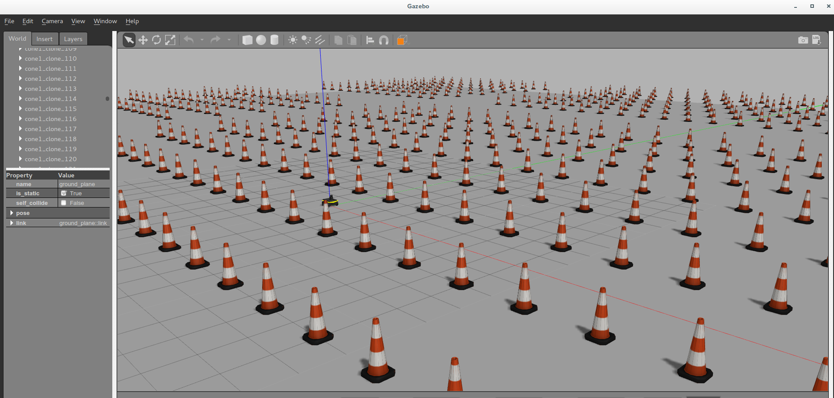
The effect of orchard heterogeneity on navigating an autonomous vehicle for agricultural tasks
Submits: Liron Shenkar
Supervisors Prof. Amir Degani , Omer Shalev

Slide 2
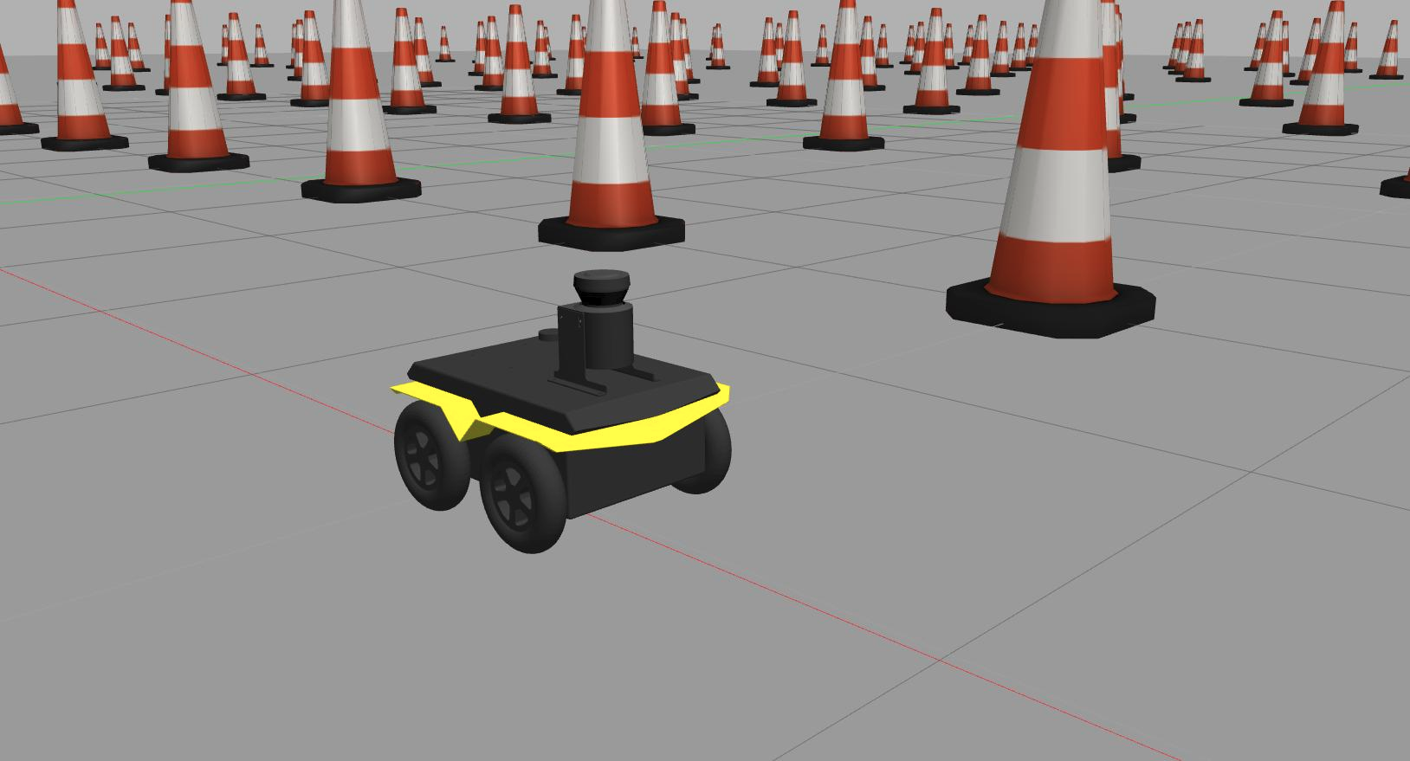
Project Structure and general info
Project Goal: To examine the performance of AMCL global localization algorithm under various heterogeneities of an orchard of cones.
The AMCL localization algorithm is a version of a particle filter.
Like any localization algorithm, It gets a map of the area of interest (called “ground truth”) and some measurements (laser scan).
Having both, the algorithm shall try to find the robot’s location on the map ,which is called “hypothesis”. The robot is CLEARPATH® jackal.
Like humans, localization algorithms seek for some distinguishable landmarks in the area (“anchors”) in order to locate themselves on the given map.
The higher the homogeneity
of the area-the harder it is to
deliver good localization results.
We wish to know how exactly
homogeneities
influences AMCL performance.

Slide 3
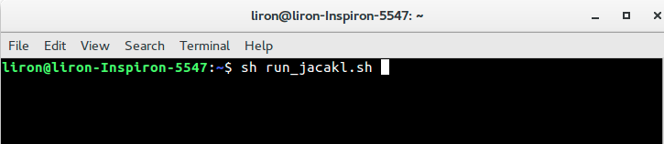
Project Structure and general info
All project files are in jackal_navigation dir, inside linux user’s home directory.
Directory contents in based on jackal navigation stack from CLEARPATH® website
https://www.clearpathrobotics.com/assets/guides/jackal/simulation.html downloaded from source
Project is running on UBUNTU 16 (Xenial) using ROS Kinetic and Gazebo 7.2
Single Command running
    There are two linux scripts inside the user’s home directory:
      run_jacakl.sh - calls all launch files, python scripts, etc.
      mybash.sh – used from creating a new map. Usually called from run_jacakl.sh and not by the user.
    Please install Terminator software on your machine as the scrips uses it.
    Running example:

Slide 4
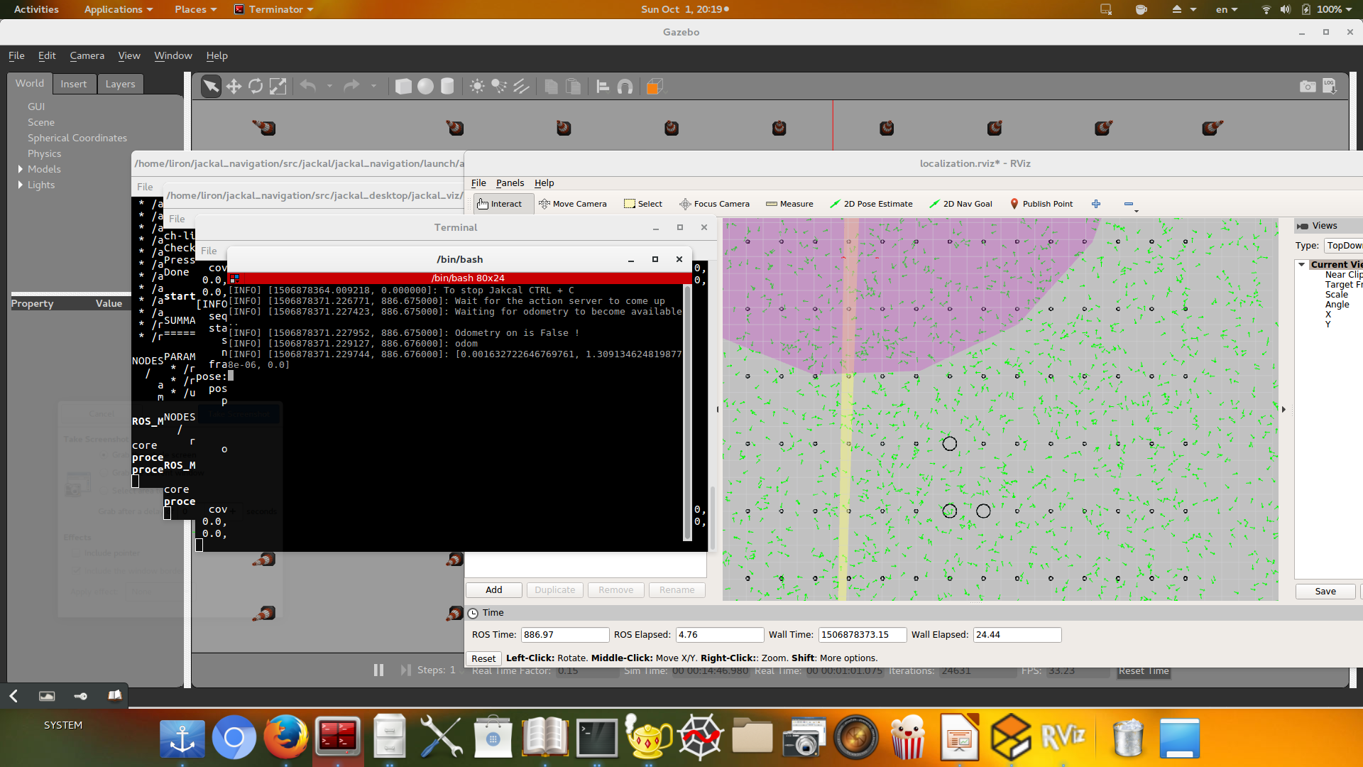
Project Structure and general info
What happens when the run_jackal script is invoked?
In short-Everything. The high level of automation was a key principle of the project since it enables to run many successive simulations easily and get the results rather quickly.
Several terminals are opened one after the other- among them the Gazebo and the Rviz windows. The robot starts moving and the AMCL node is being launched.

Slide 5
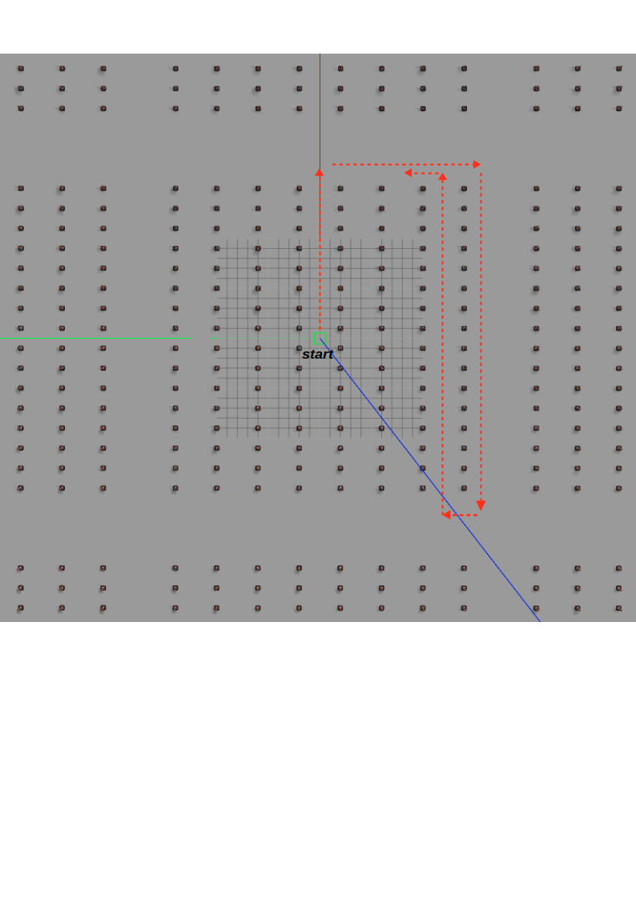
Project Structure and general info
What happens when the run_jackal script is invoked (cont.)?
A script moves the robot in the path shown below- heading forward and rightwards, and than travel between the orchard’s columns.
Due to angular errors caused by odometry inaccuracy and timing Inaccuracies of the Gazebo simulator, the jackal always bumped into a cone. The actual path was not consistent, even when running successive simulations under the same conditions.
Even though- Understanding of the AMCL behavior and the ability of gathering insights about its performance remained intact.
The “heart” of the problem was the AMCL
global localization, which Is invoked
immediately, usually before the above errors
takes a significant place.

Slide 6
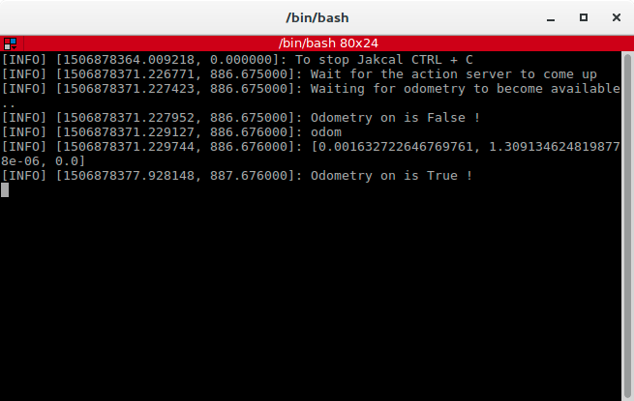
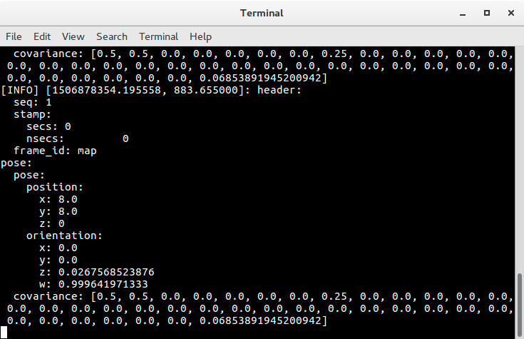
Project Structure and general info
What happens when the run_jackal script is invoked (cont.)?
In order to stop the robot, one has to terminate (CTRL+C) the Terminator window seen below.
In order to create maps (explained in the coming slides) , one has to terminate (CTRL+C) the terminal seen below.

Slide 7
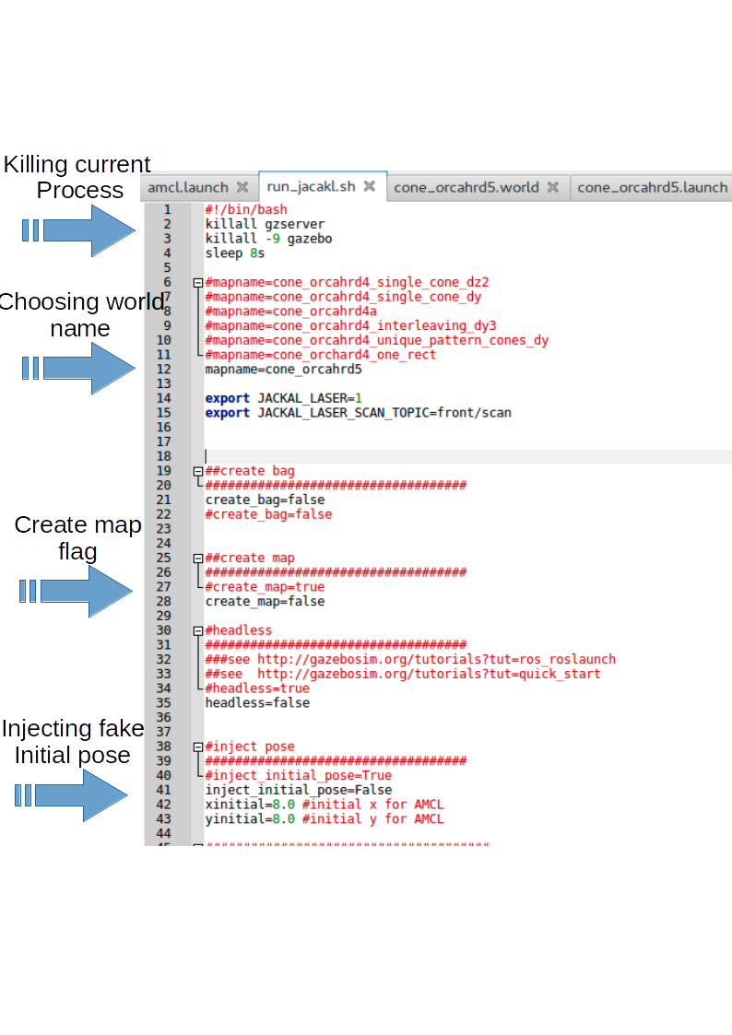
Project Structure and info
run_jackal.sh file structure:

Slide 8
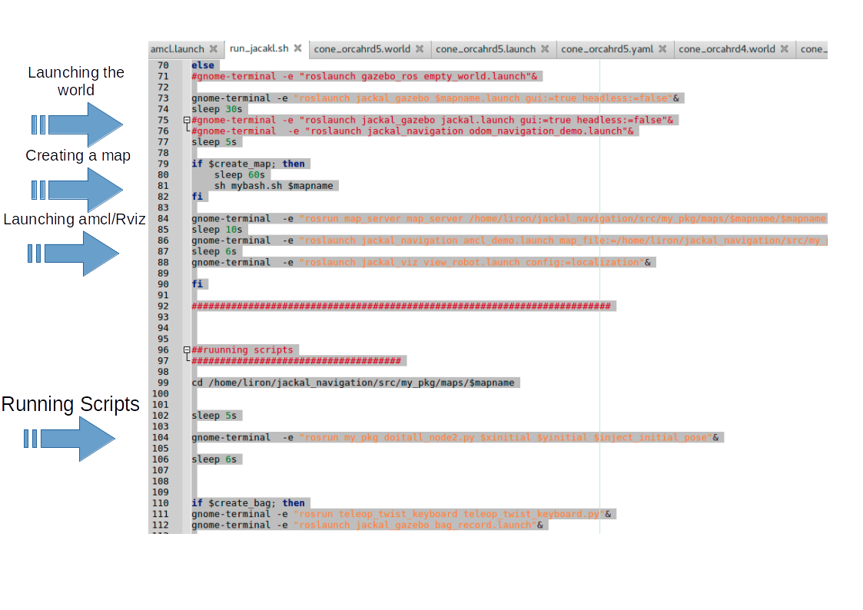
Project Structure and info
run_jackal.sh file structure (Cont.):

Slide 9
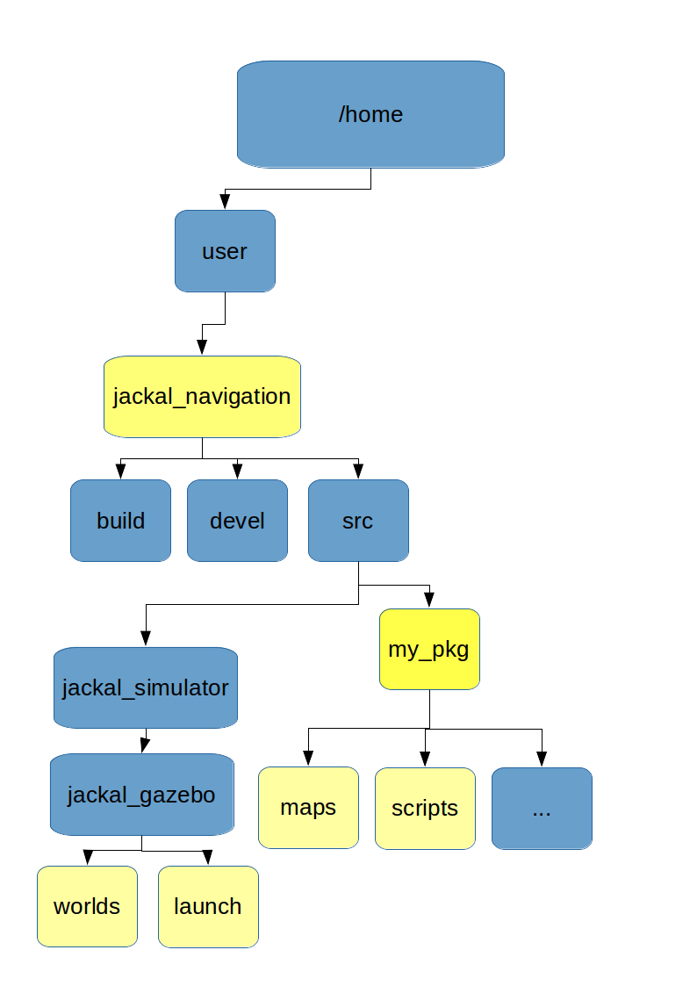
Project Structure and info
Folder Structure is shown on the diagram on the left.
The worlds and launch files are exacley where they are on the navigation stack.
One added package called my_pkg using Catkin make.
The package contains mainly python scripts and maps.
The maps folder contains maps and graphs.
Graphs are created automatically after every
simulation is terminated using ctrl+c.
Maps are created if the flag “create_map” on
run_jackal script is set to true.

Slide 10
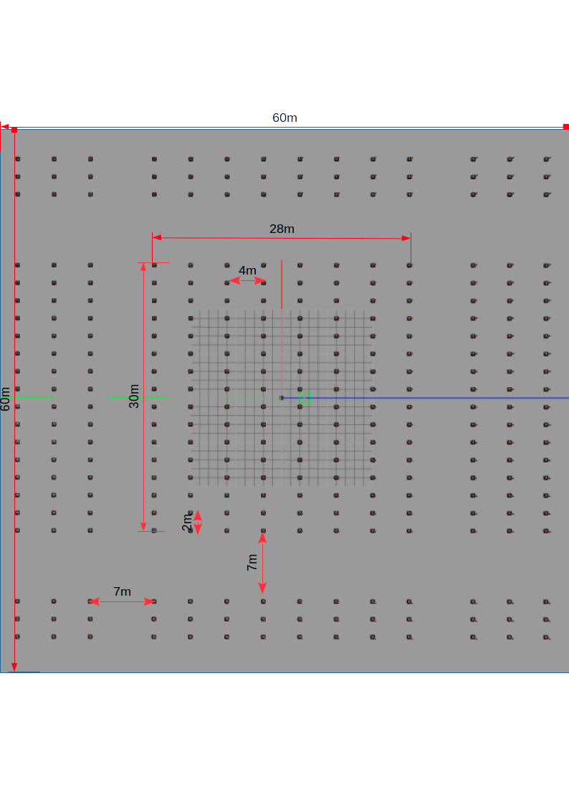
The world

Slide 11
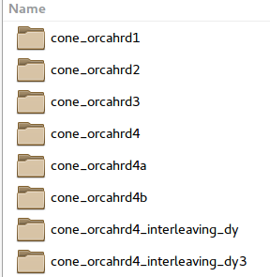
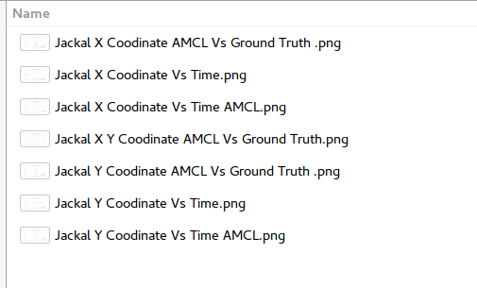
Project Structure and info
What’s inside maps dir?
Each folder carries the name of the Gazebo world on
which the simulation is being running on.
When running the simulation,several terminals are opened:
for gazebo, Rviz, AMCL and some other nodes.
When terminating the AMCL terminal
(Ctrl+C) - graphs are created automatically
and saved inside the appropriate folder.

Slide 12
Project Structure and info
What’s inside maps dir (cont.)?
The graphs created are:
  X vs time- ground truth
  Y vs time- ground truth
  X vs time- ground AMCL
  Y vs time- ground AMCL
  X vs time- ground truth & AMCL
  Y vs time- ground truth & AMCL
  X Y ground truth & AMCL (trajectory - no time)

Slide 13
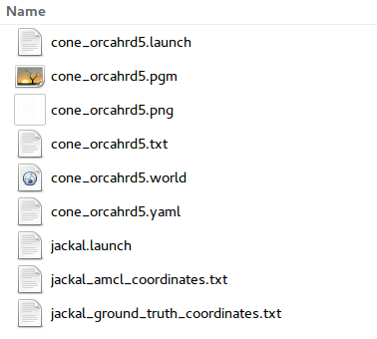
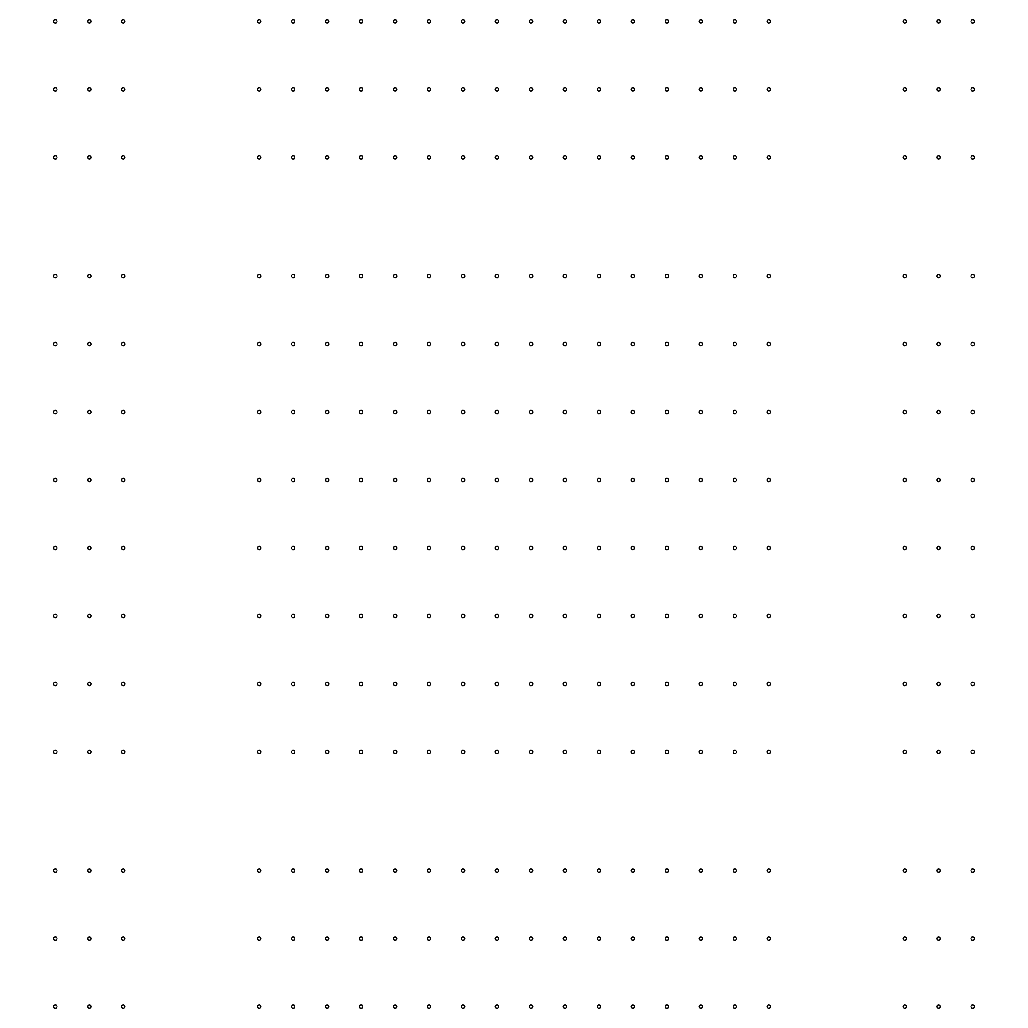
Project Structure and info
What’s inside maps dir?
There are copies of the world and launch files from the jackal_gazebo directory.
Two images .pgm & .png which are the ground truth map. Both can be used.
Text files of the ground truth/AMCL messages
after parsing.
worldname.txt – used for creating the map.
.yaml file- used by Rviz for reading the map properly.
map

Slide 14
Project Structure and info
Amcl.launch file
The amcl.launch file contains all the parameters needed for the AMCL node.
Important! - The parameters were adjusted carefully . Please read http://wiki.ros.org/amcl , and especially https://answers.ros.org/question/227811/tuning-amcls-diff-corrected-and-omni-corrected-odom-models/

Slide 15
Project Structure and info
Project location
One has to first install the jackal_navigation stack and then add my_pkg package using Catkin_make
What appears on Github is only
  my_pkg directory (with the scripts and maps)
  worlds & launch files directories (their content should be coppied to the same folders inside the navigation stack)
Github :

Slide 16
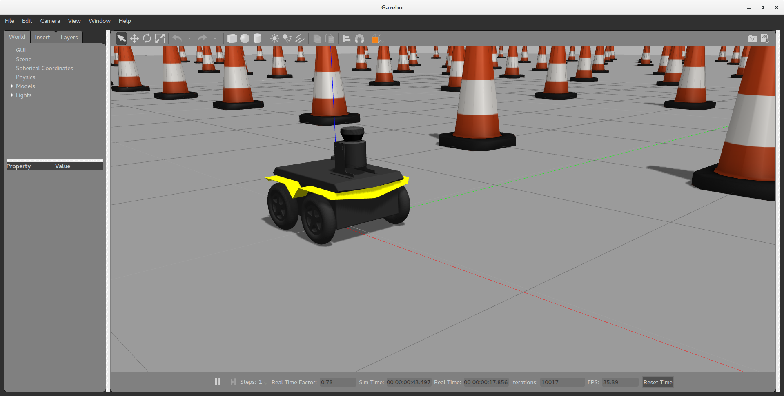
Experiments
Experiments

Slide 17
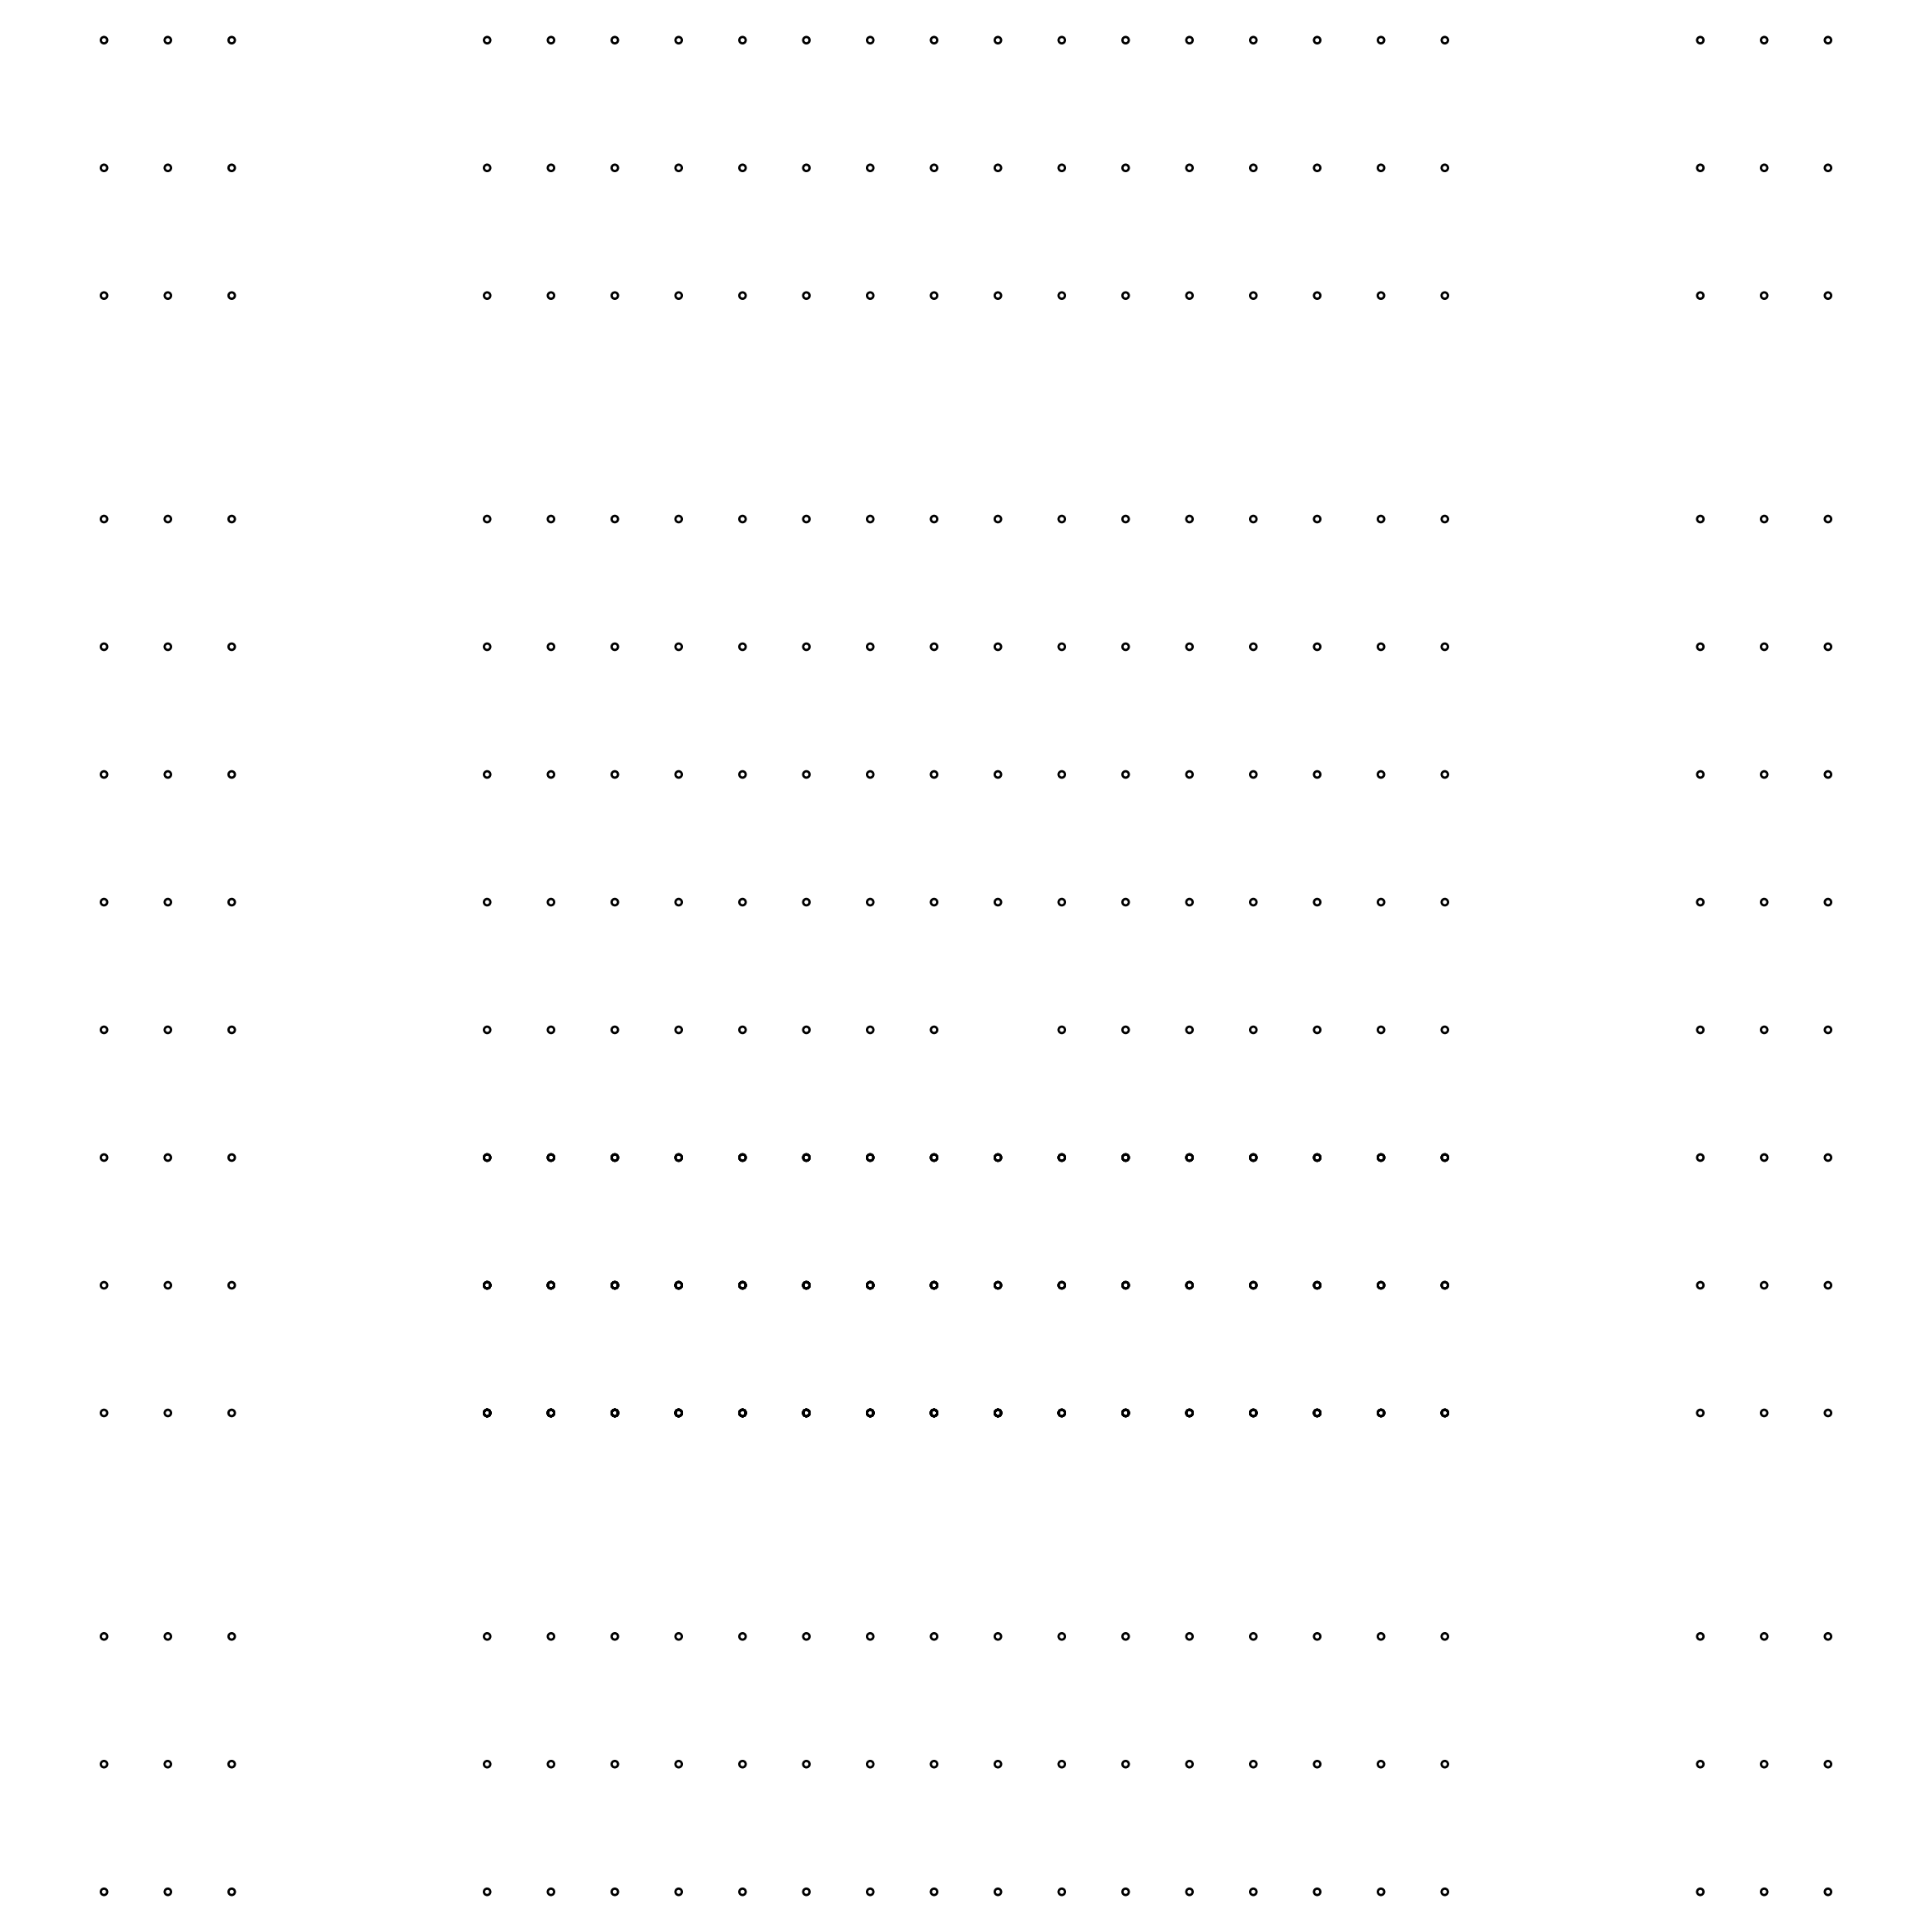
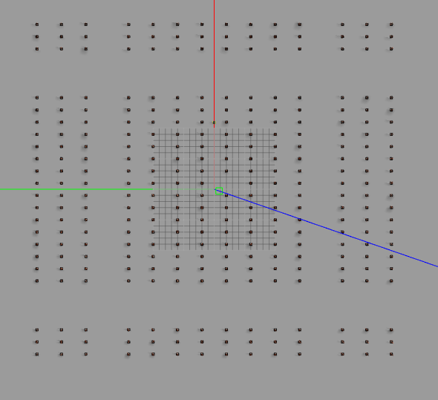
Experiment #1 : single cone missing
Wold name: cone_orcahrd5d
World Description: single cone missing, near the axis.
Special notes: Initial injected pose (8,8). 12,000 particles (max).
World map & image:

Slide 18
Experiment #1 : single cone missing
Results: 7 successive simulations- 0/10 (0%) success rate . I stopped there.
Example success graph:-N.A
There were other experiments with larger/smaller number of particles. None succeeded

Slide 19
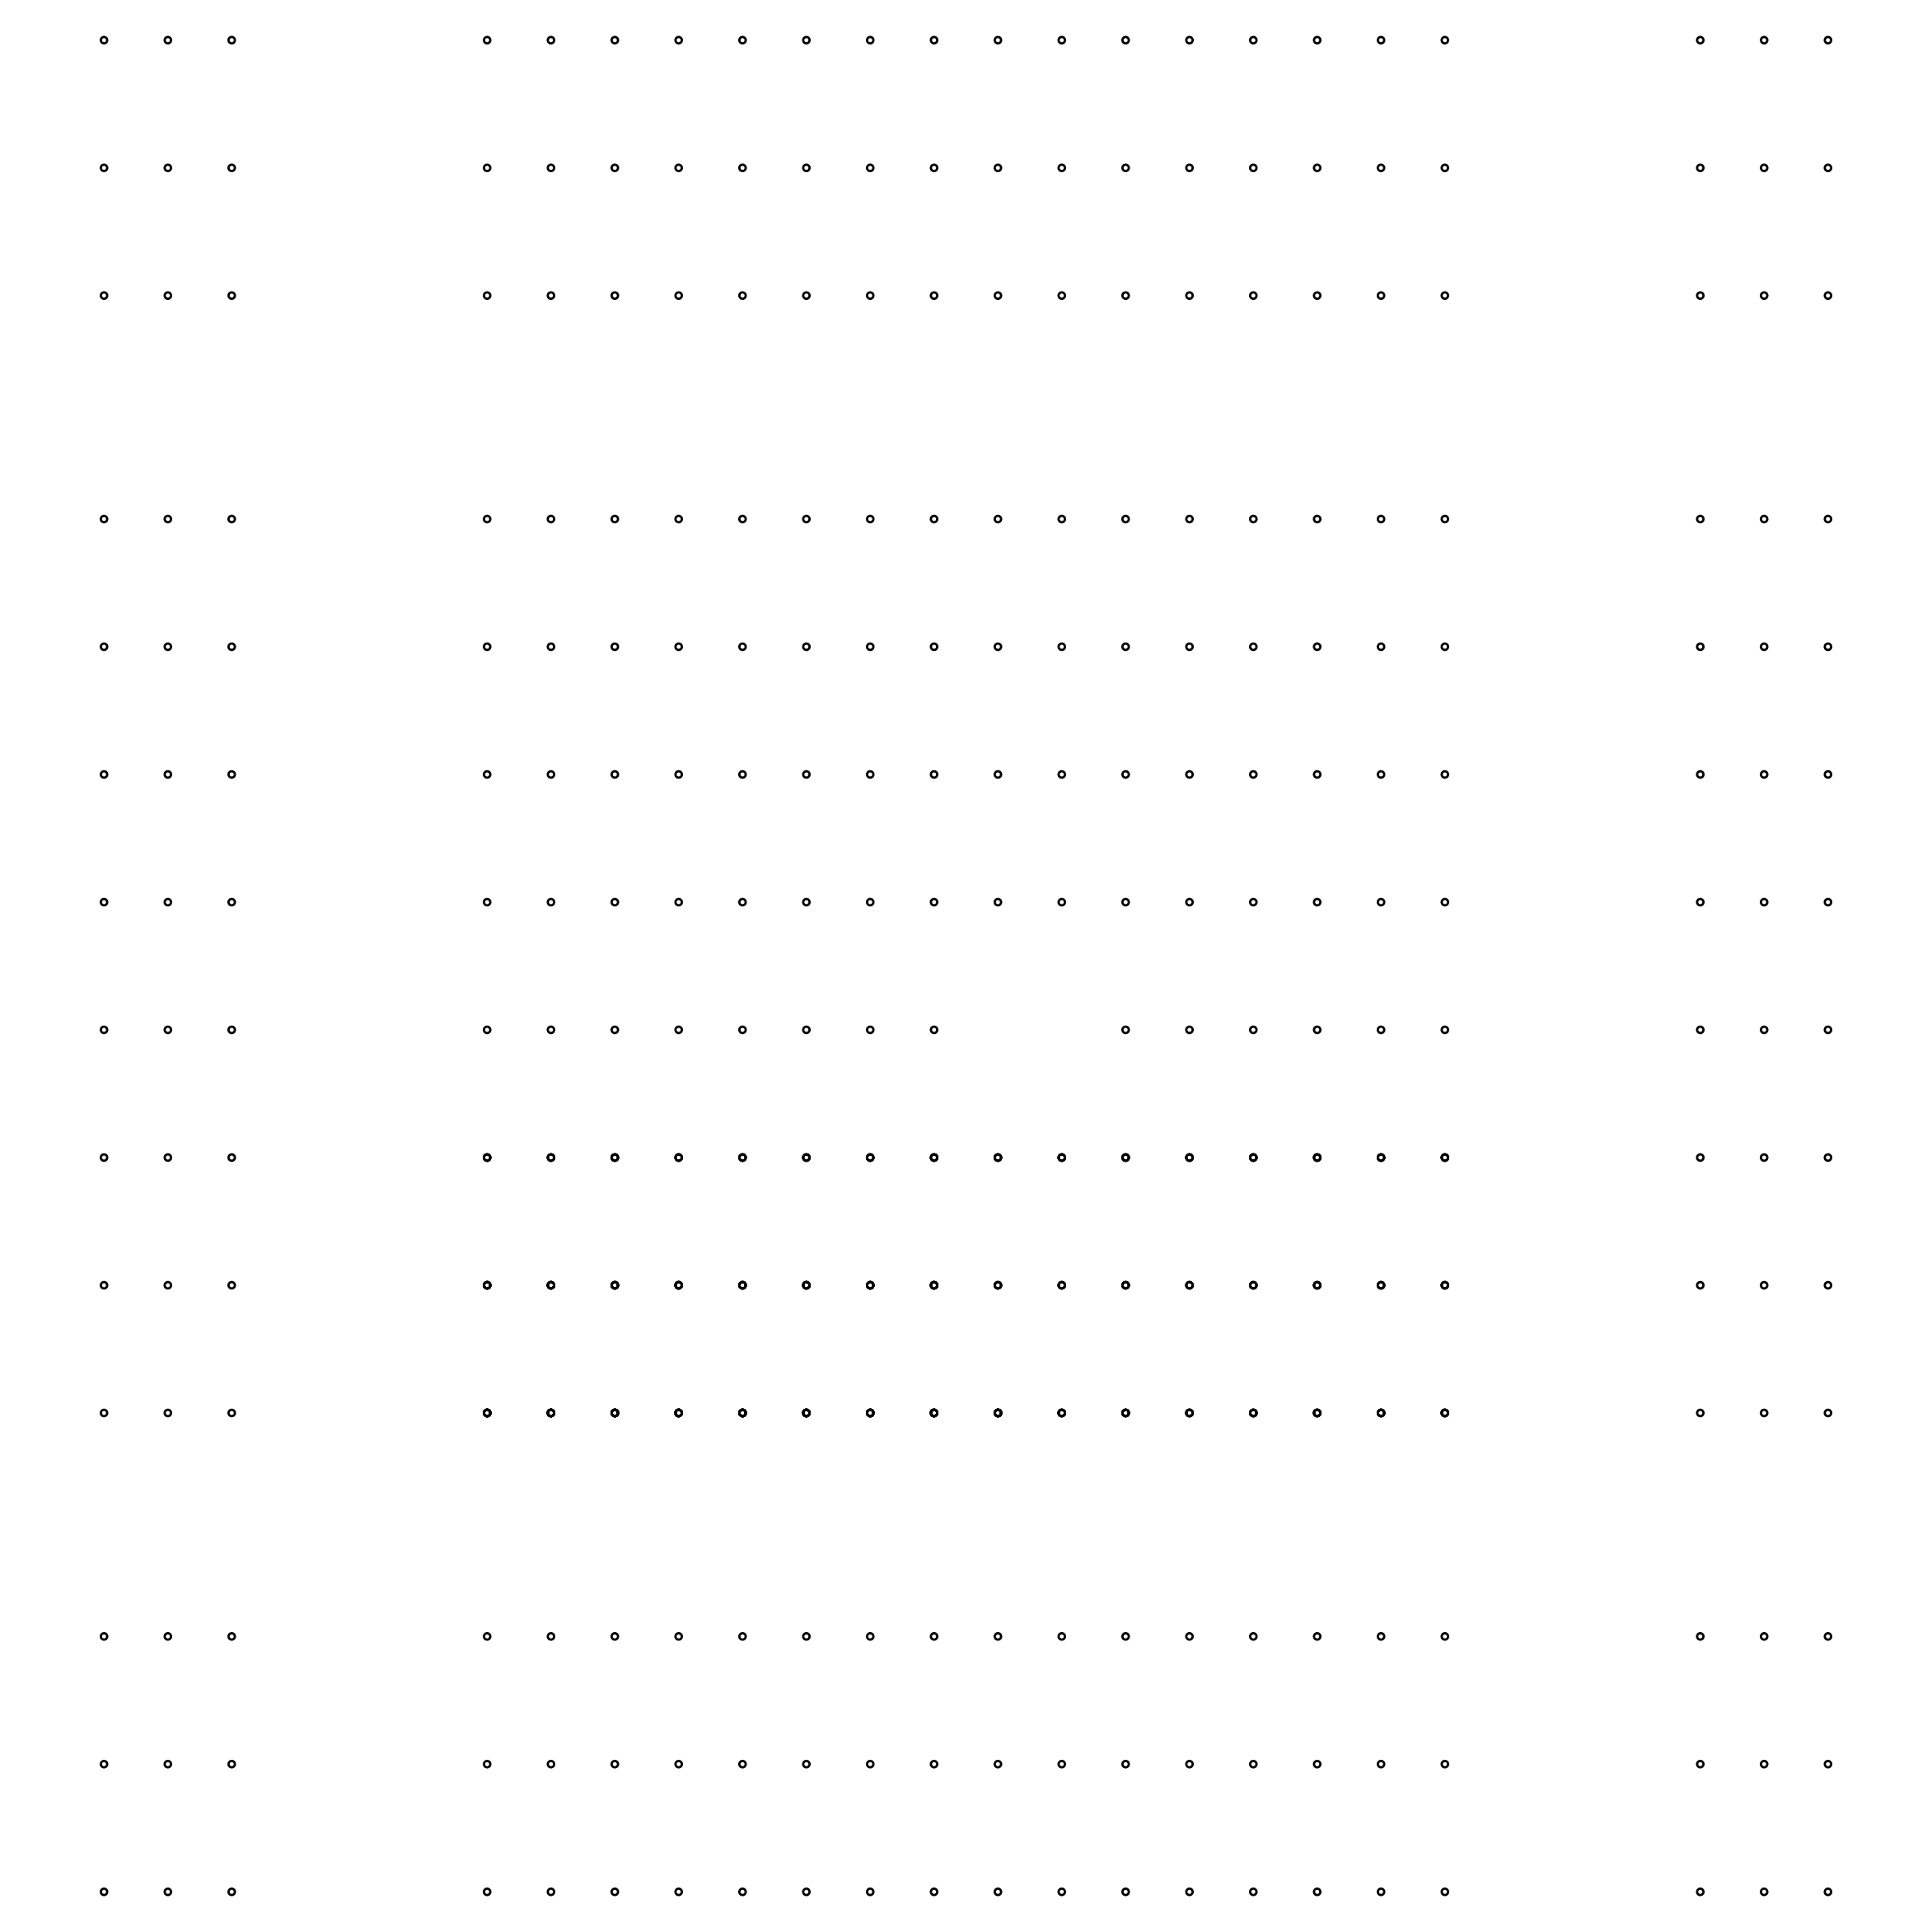
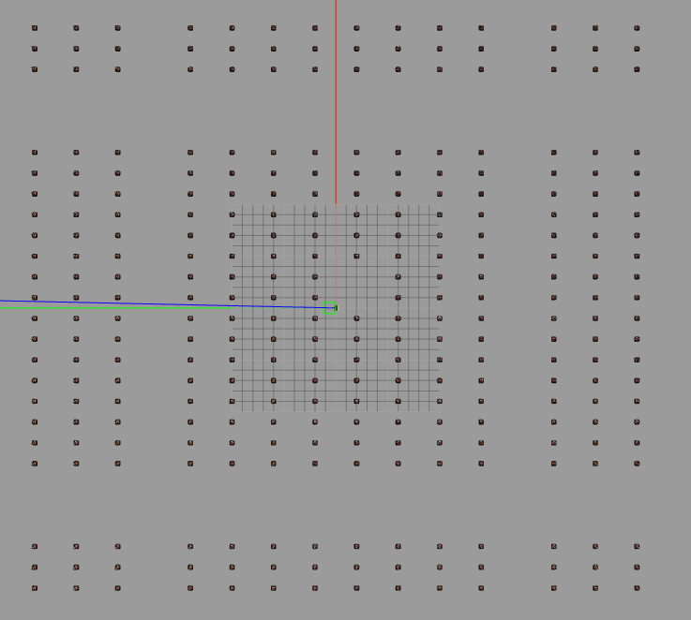
Experiment #2 : two cones missing
Wold name: cone_orcahrd5b
World Description: Two cones missing near the starting point.
Special notes: Initial injected pose (8,8). 12,000-30000 particles (max).
World map & image:

Slide 20
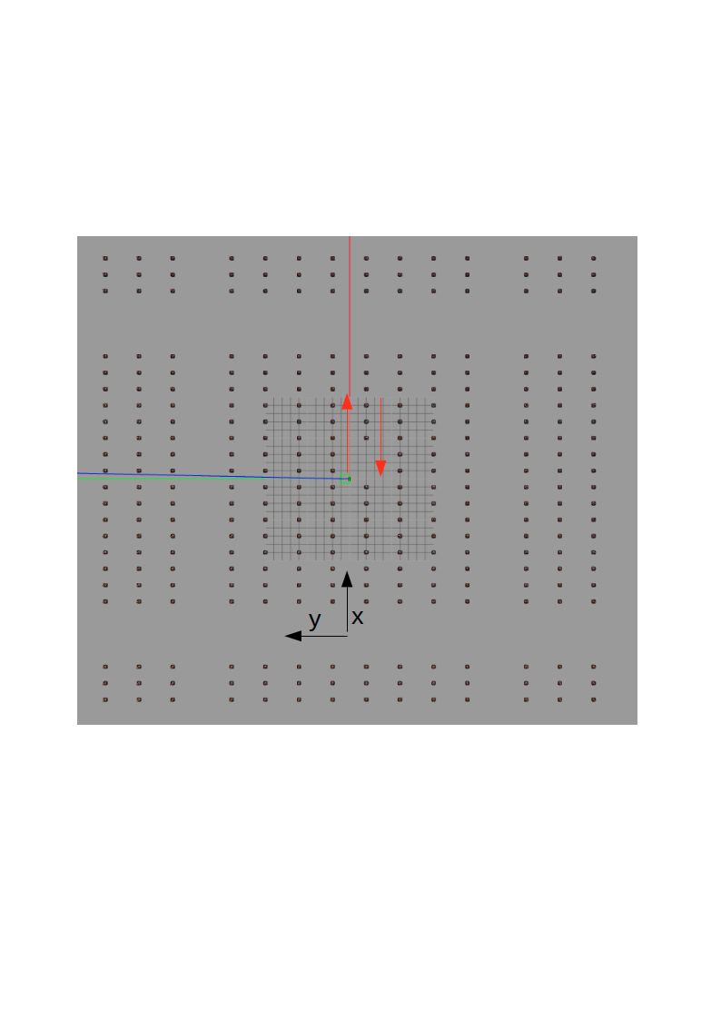
Experiment #2 : two cones missing
Special note: “Success” in this experiment is considered one of the two possibilities of the AMCL solutions-
  Locating the jackal in the row y=0 heading in the positive direction.
  Locating the jackal in the row y=-4 heading in the negative direction.
This is because both cases might look the same form the Jackal’s point of view having only laser scan and the map. The x coordinate must be correct in order to count a “success”.

Slide 21
Experiment #2 : two cones missing
Results: 10 successive simulations- 0/22 (0%) success rate.
Example success graph-None:

Slide 22
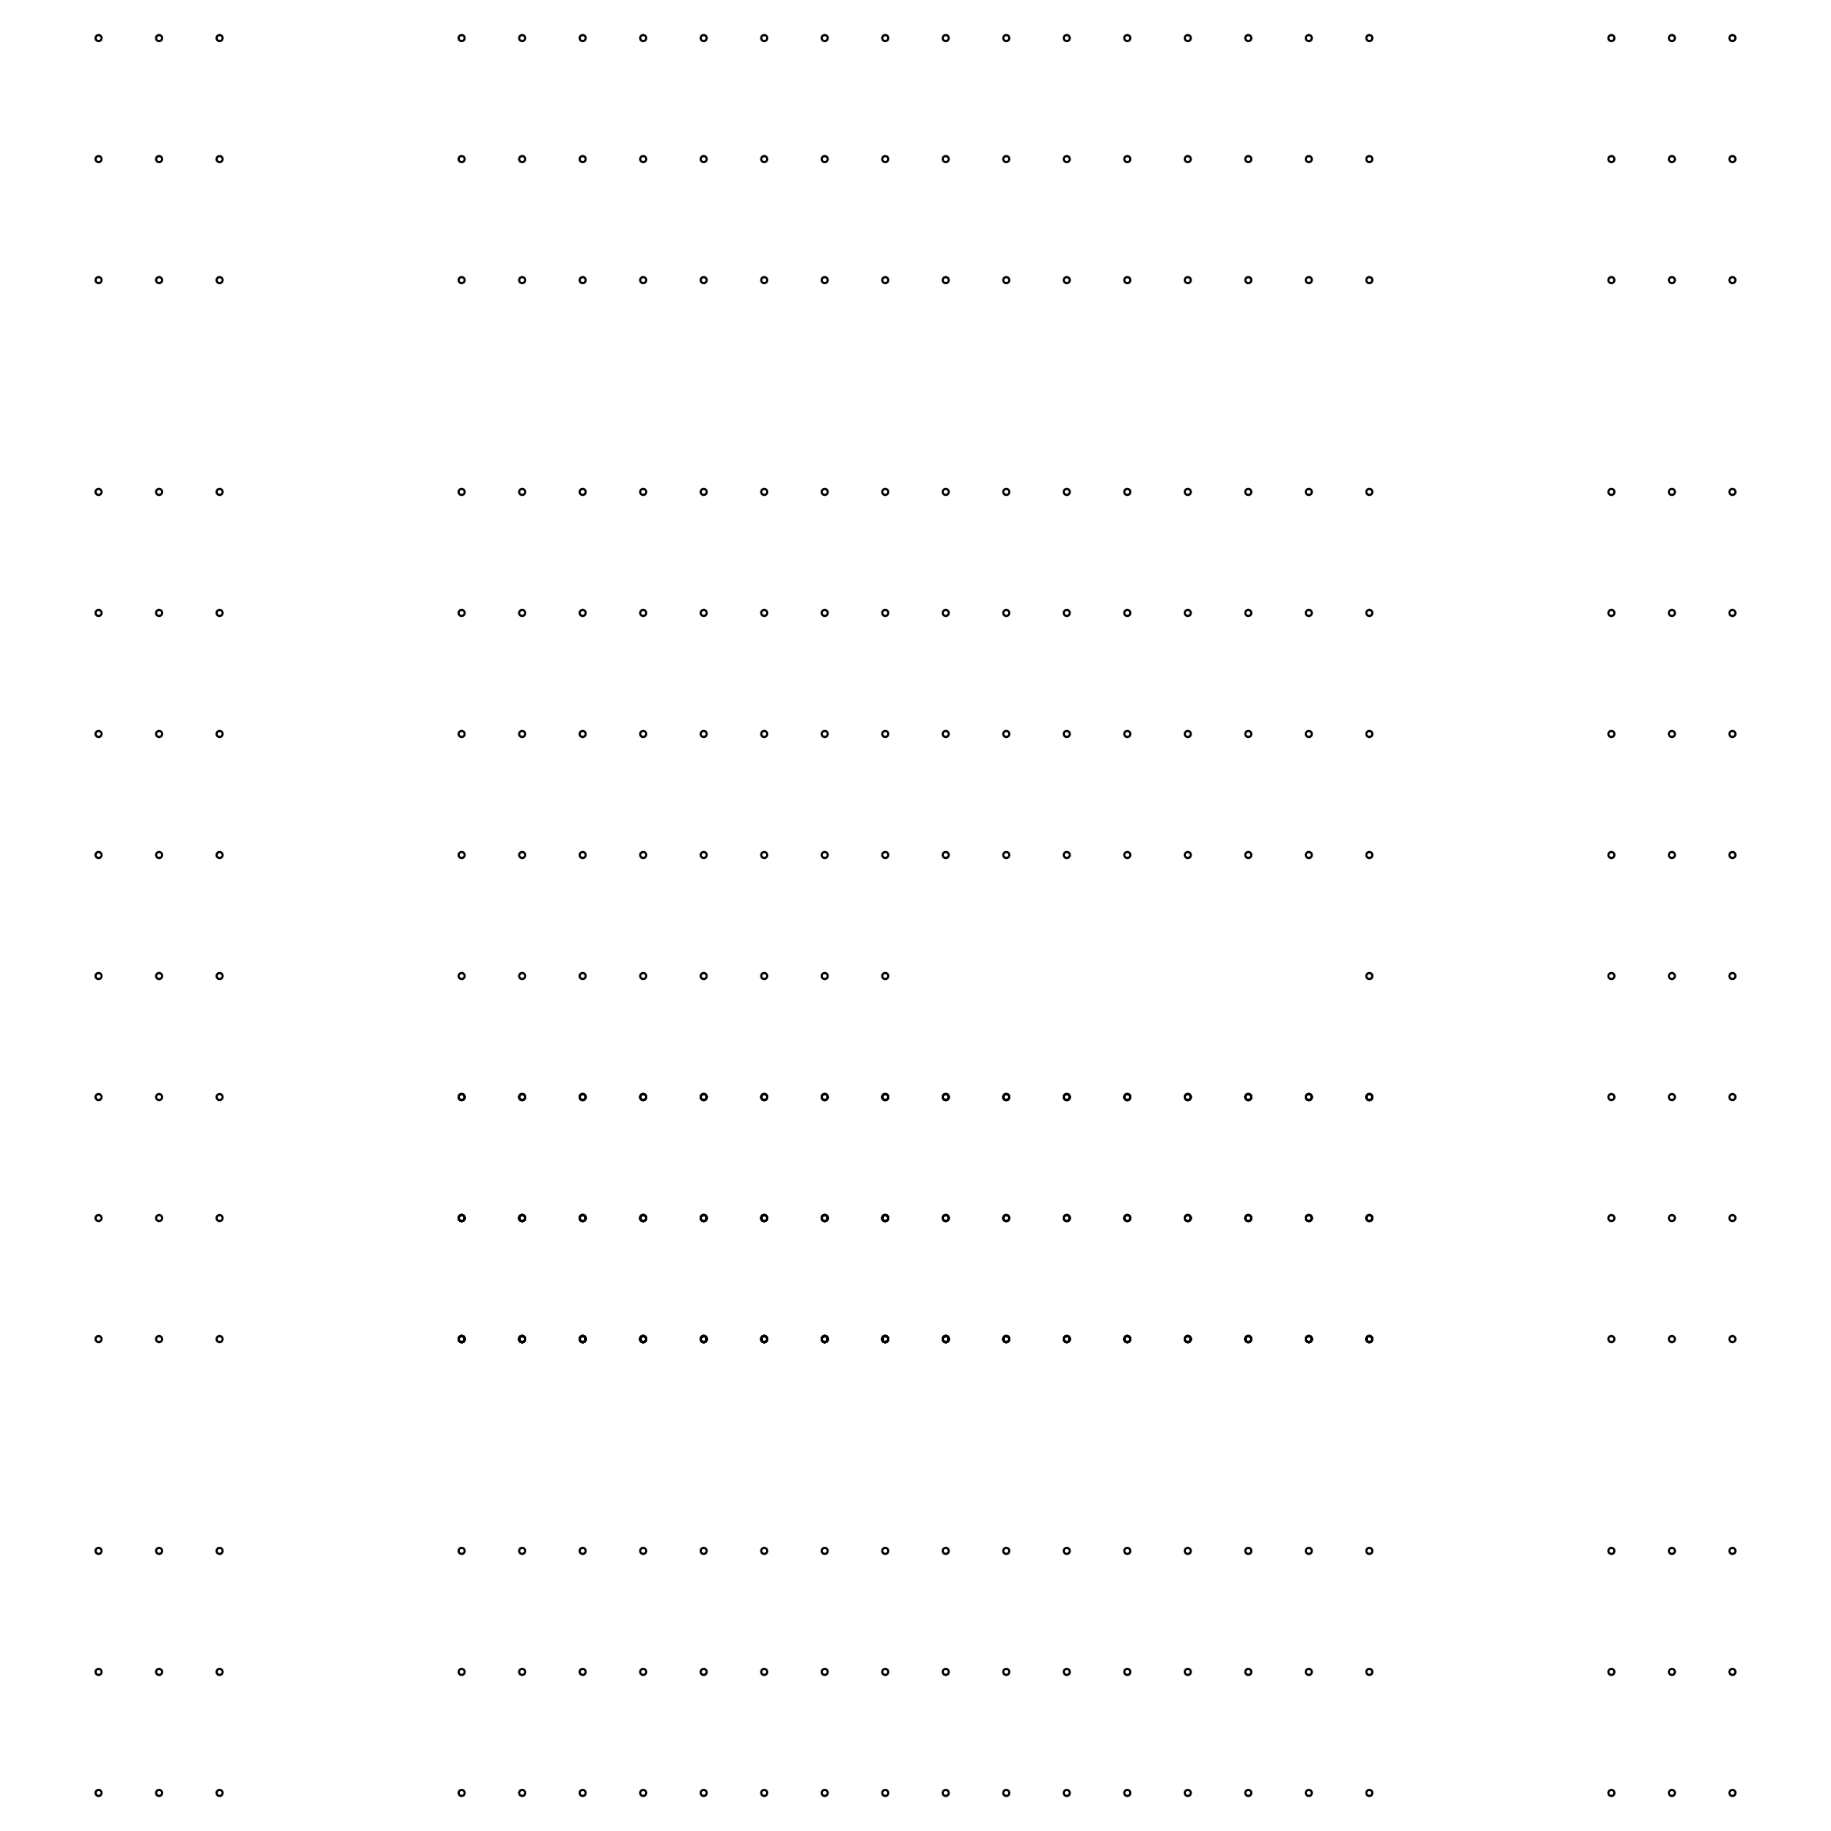
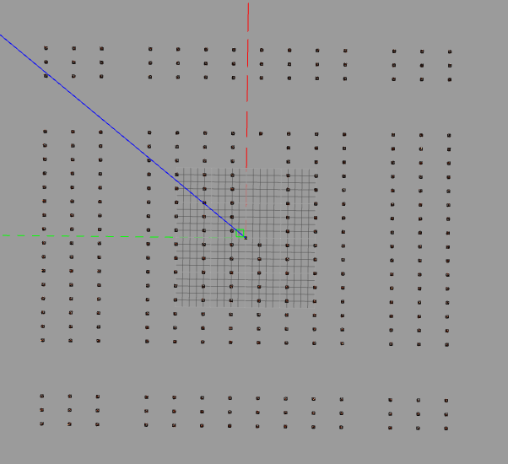
Experiment #3 : half row missing
Wold name: cone_orcahrd5c
World Description: (nearly) half a row of cones missing.
Special notes: Initial injected pose (8,8). 12,000 particles (max).
World map & image:

Slide 23
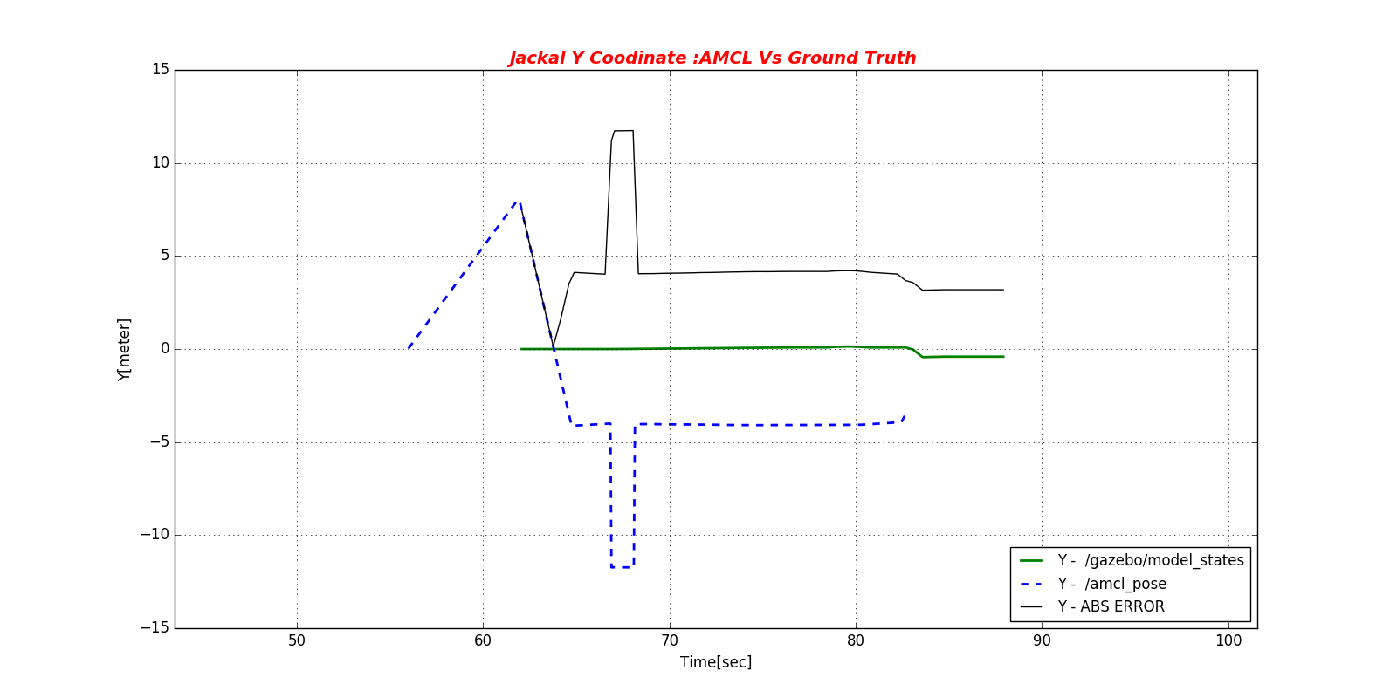
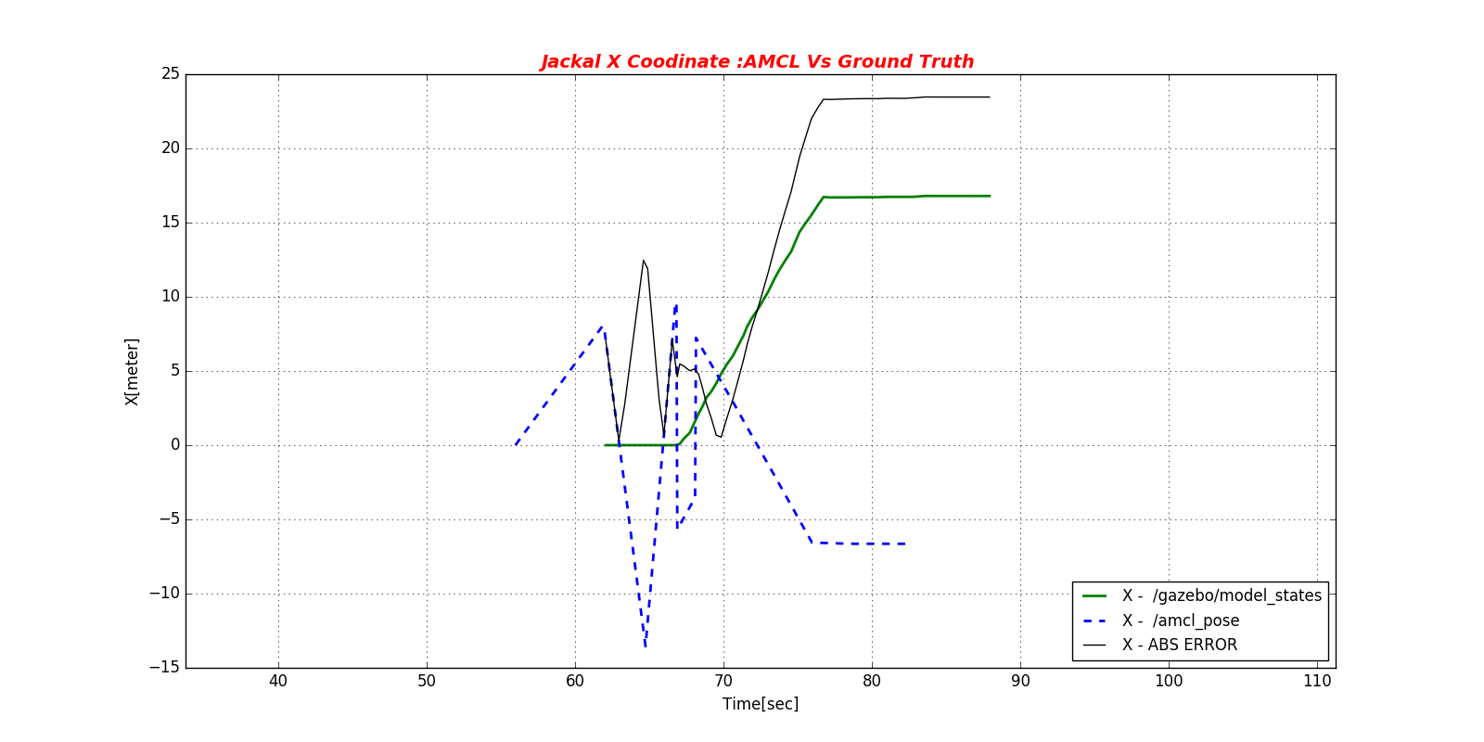
Experiment #3 : half row missing
Results: 10 successive simulations- 6/10 (60%) success rate .
Example success graph:
Note that this is an example of negative X-direction velocity and
Y=-4 and not 0, which is considered valid No matters the X.

Slide 24
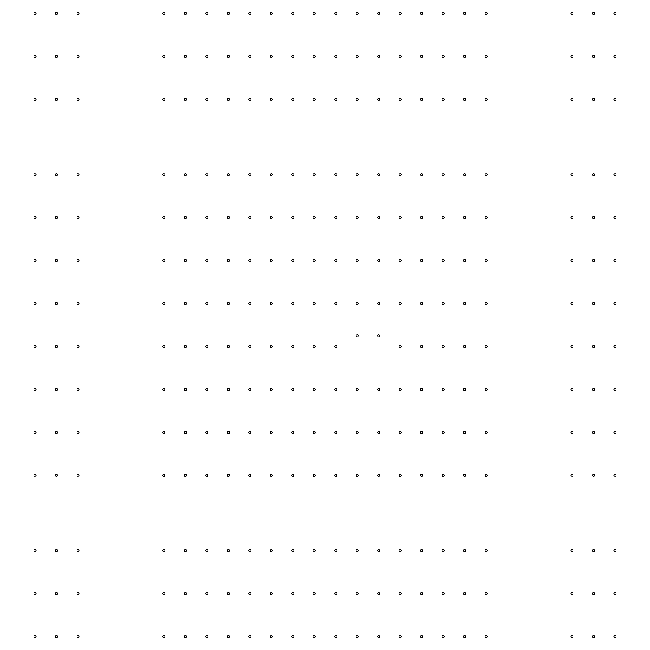
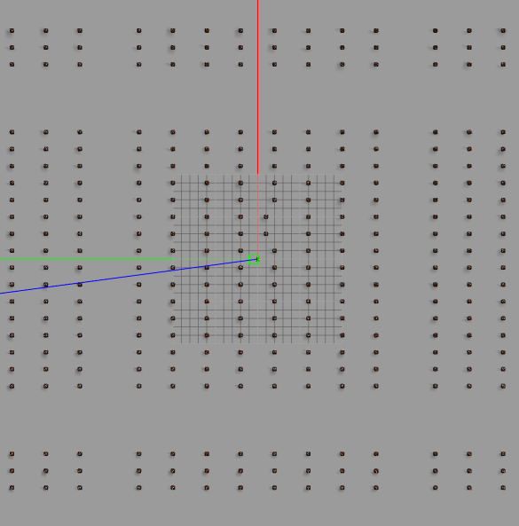
Experiment #4 : two cones out of line
Wold name: cone_orcahrd6b
World Description: No cones missing, two cones are 1m ahead, near the axis.
Special notes: Initial injected pose (8,8). various number of particles tested .
World map & image:

Slide 25
Experiment #4 : two cones out of line
Wold name: cone_orcahrd6a
World Description: No cones missing, two cones are 1m ahead, near the axis.
Special notes: Initial injected pose (8,8). various number of particles tested .
World map & image:

Slide 26
Experiment #4 : two cones out of line
Results: 7 successive simulations- 0/7(0%) success rate . I stopped there. Many other experiments which were not saved showed the same result.
Example success graph:-N.A
Experiments within the interval of 8000-30000 particles were made.

Slide 27
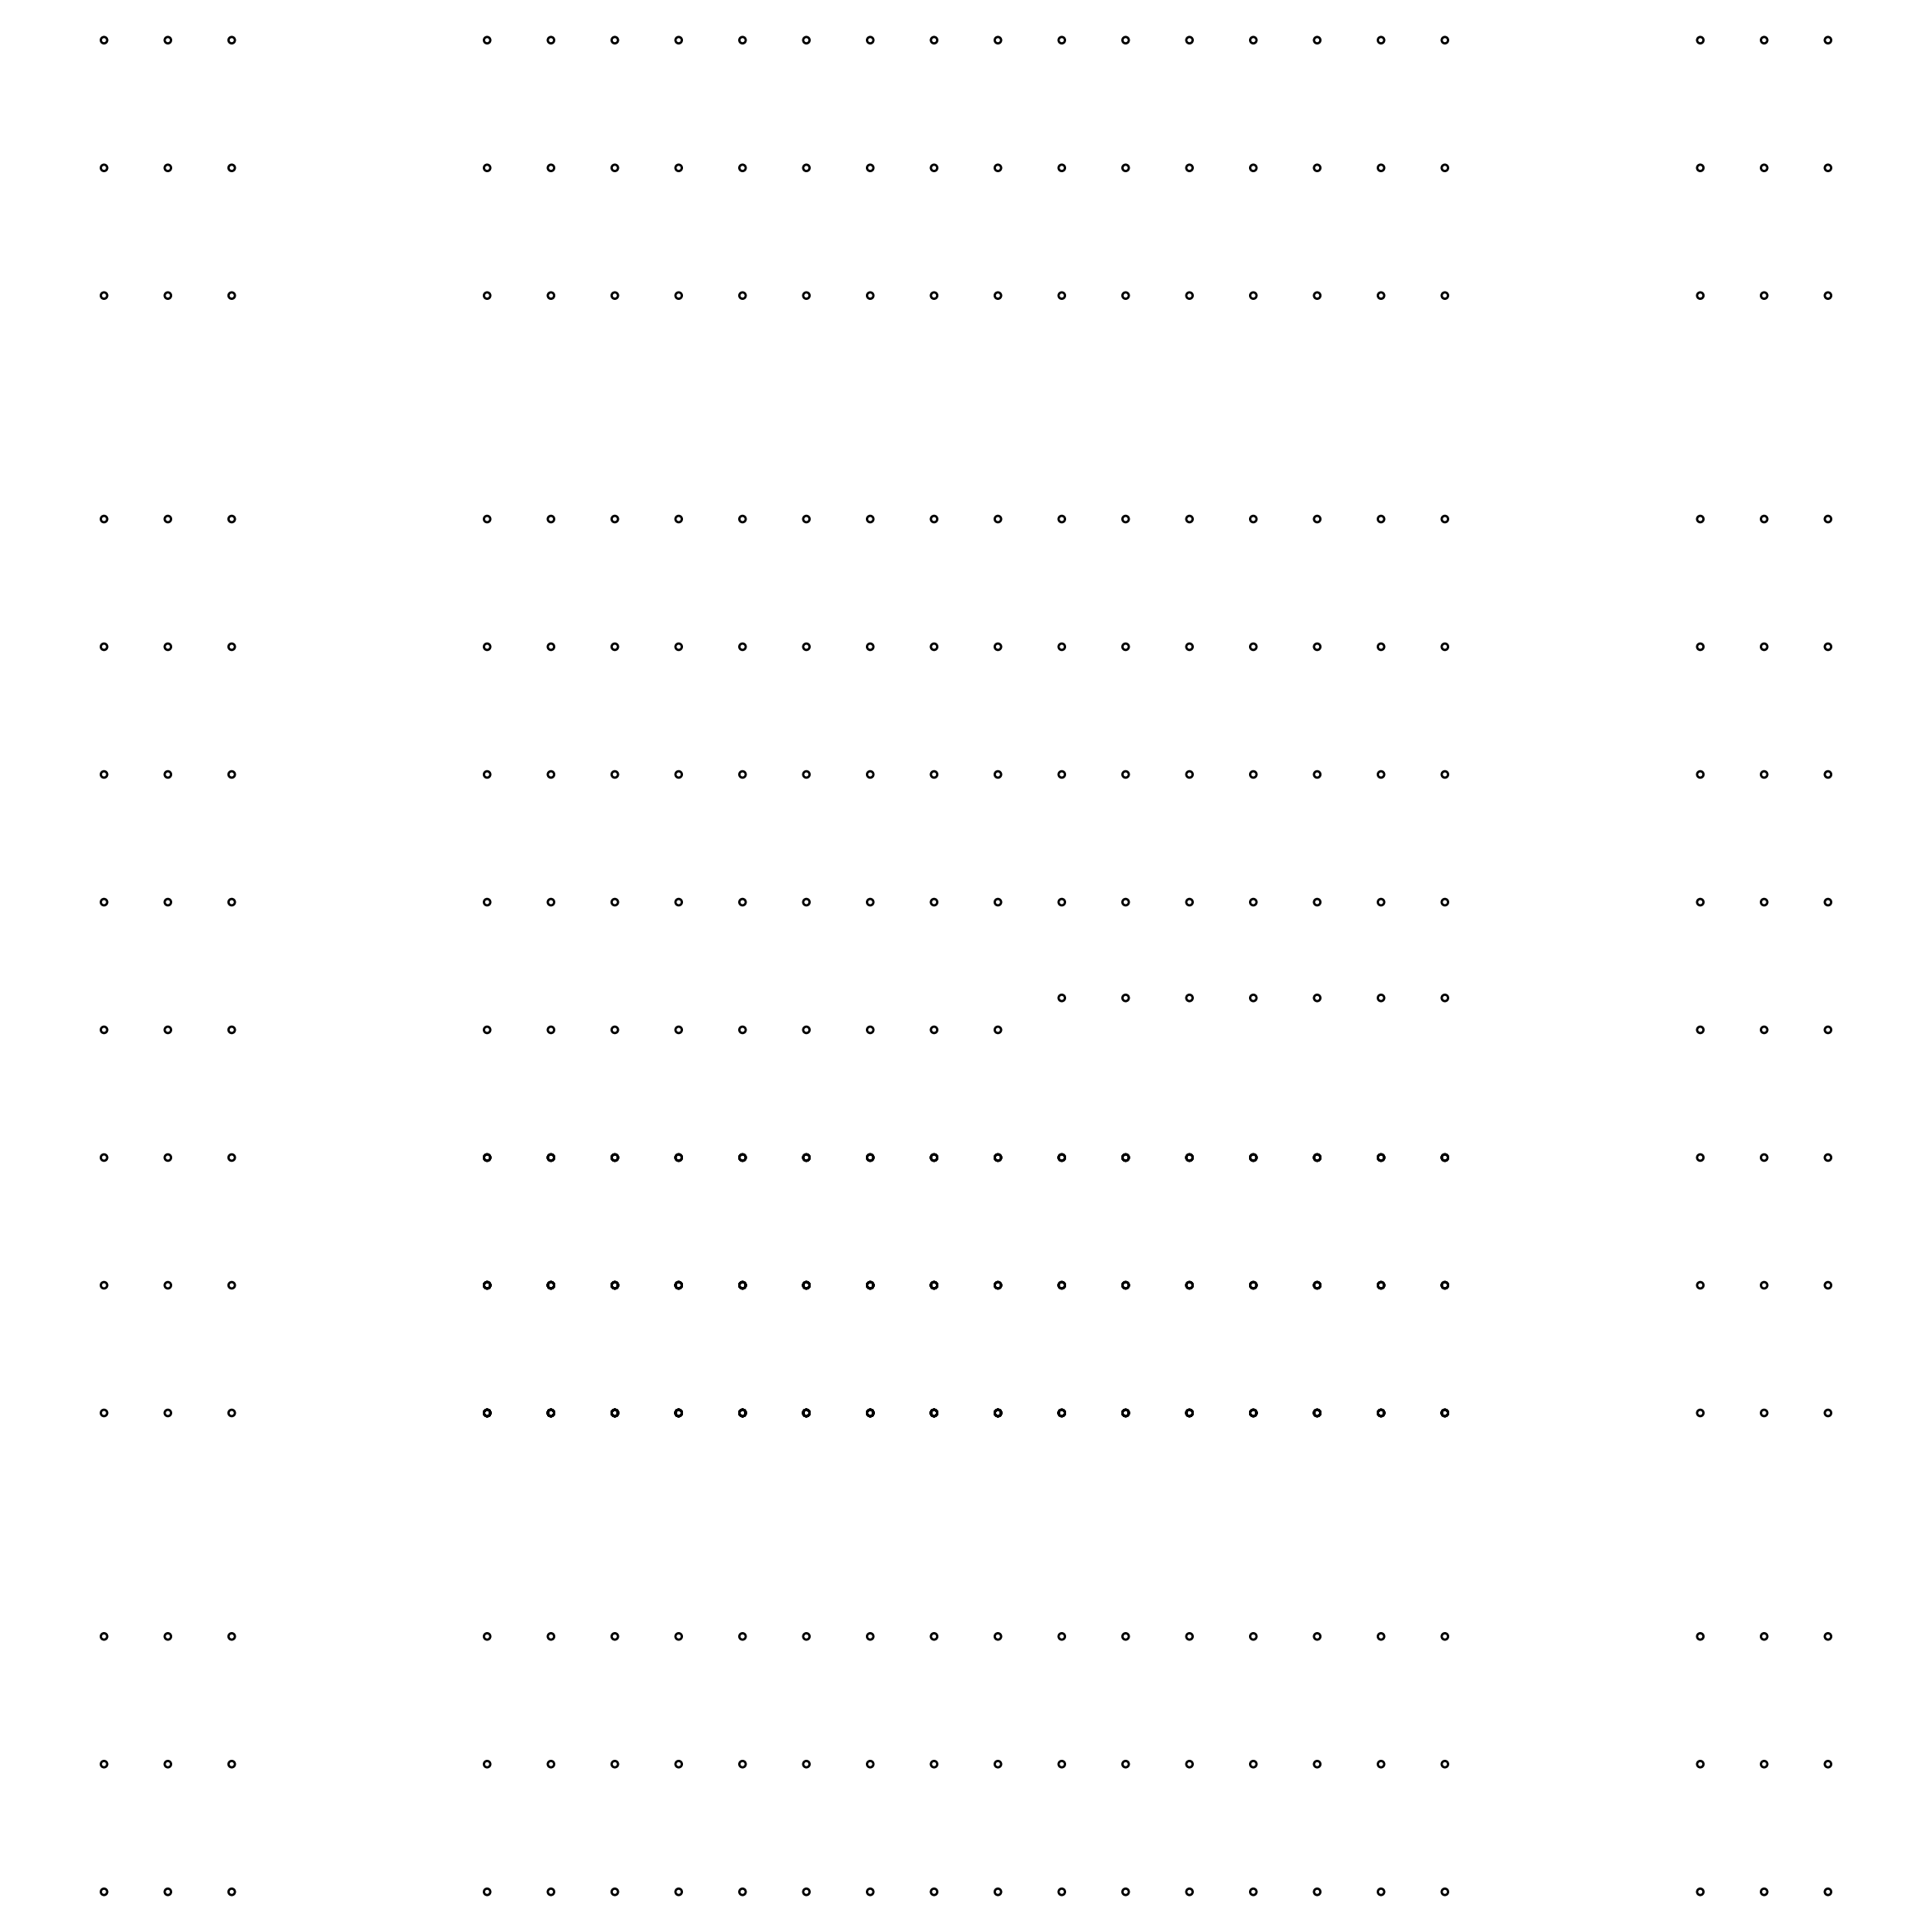
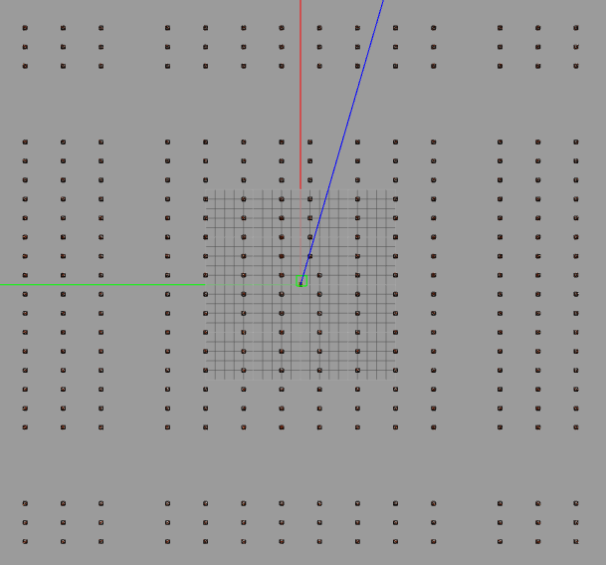
Experiment #5 : half row of cones out of line
Wold name: cone_orcahrd6b
World Description: half a row of cones are 1m ahead.
Special notes: Initial injected pose (8,8). various number of particles tested .
World map & image:

Slide 28
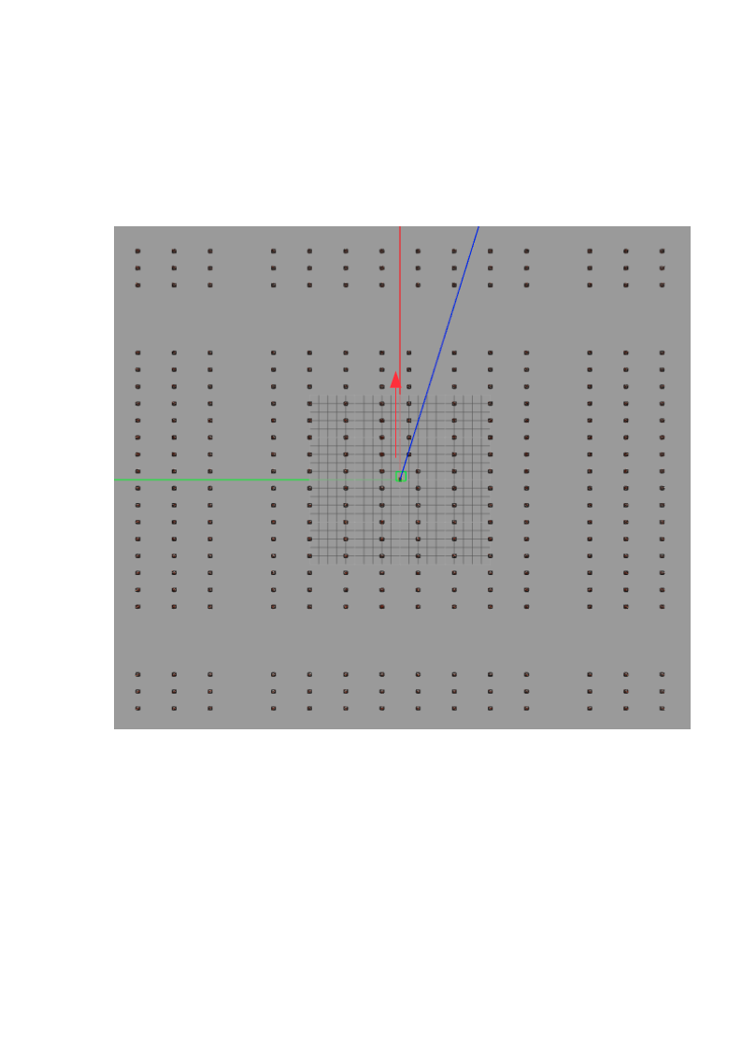
Experiment #5 : half row of cones out of line
Special note: “Success” in this experiment is considered a localization solution somewhere inside the correct row (y=0) , while the robot is heading in the right (positive x) direction
Results:
  30,000 particles- 7/8 succeeded (87.5%).
  Less (12,000 and 20,000 particles)-None (0% succeeded).

Slide 29
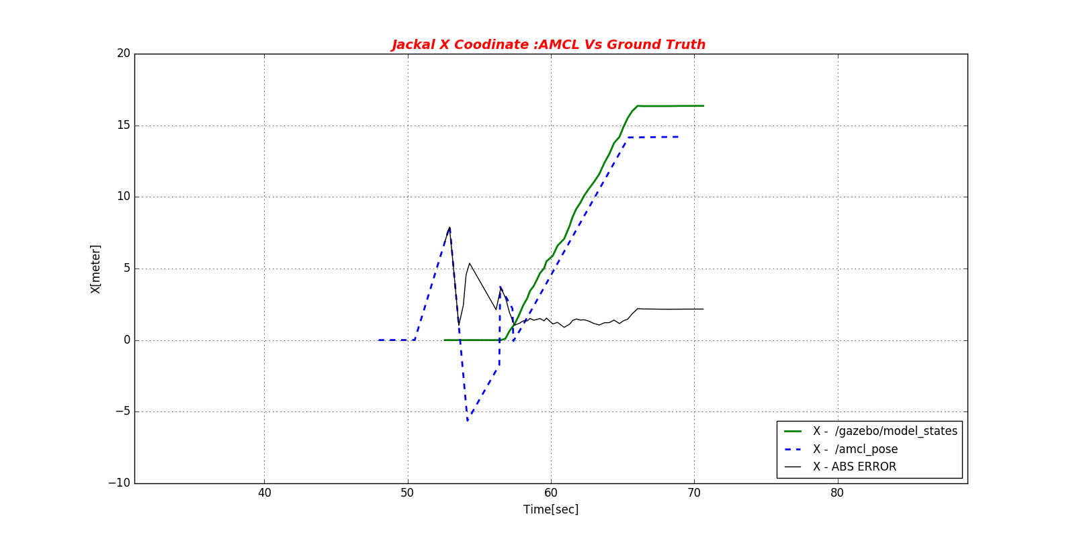
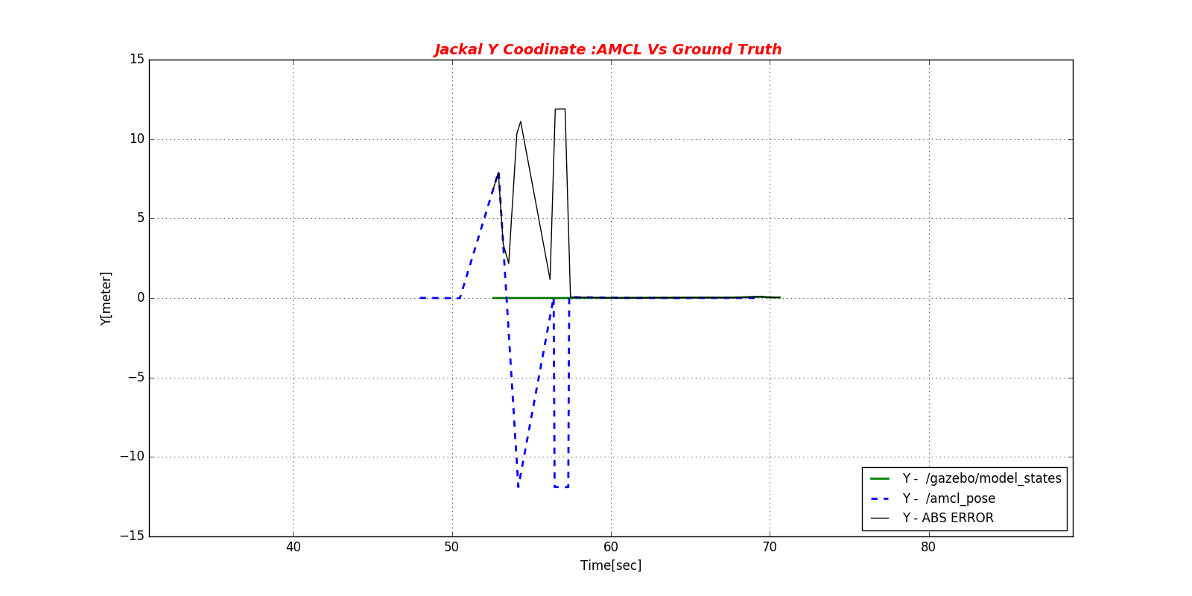
Experiment #5 : half row of cones out of line
Example success graph:

Slide 30
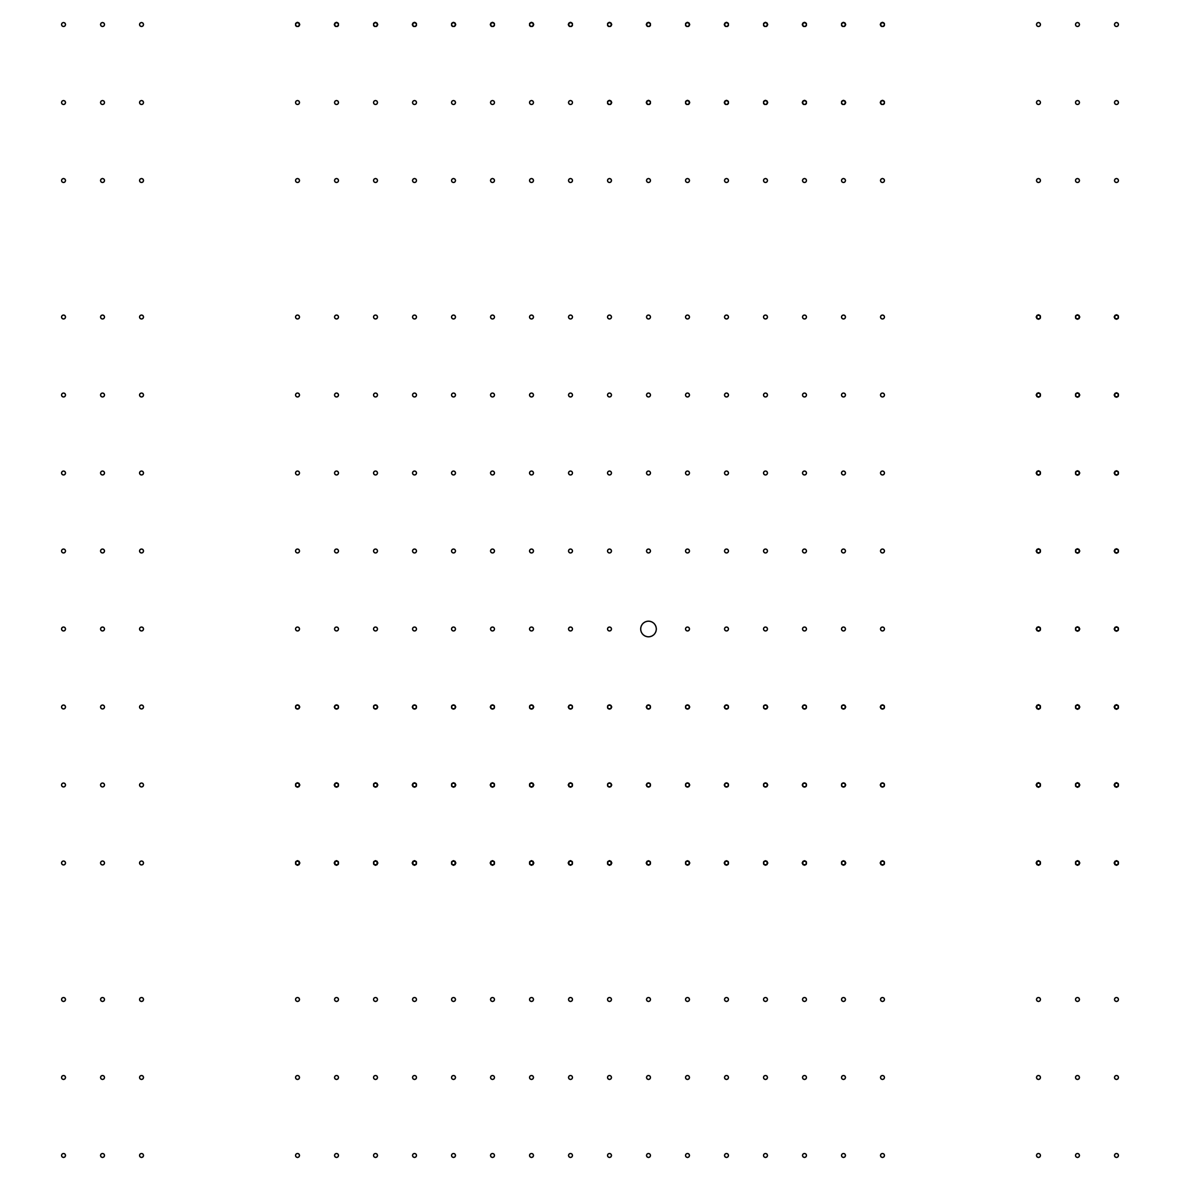
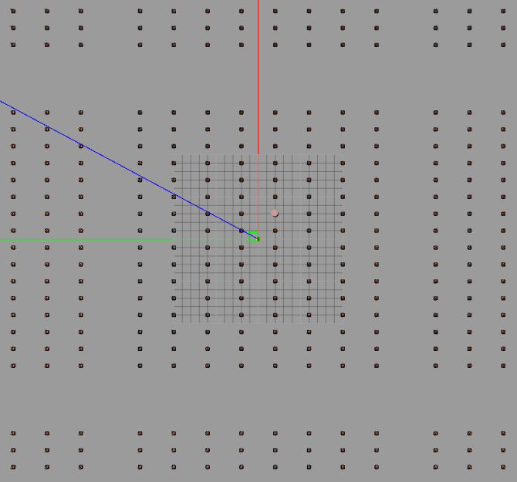
Experiment #6 : Single cylinder
Wold name: cone_orcahrd6c
World Description: A single cylinder with radius=0.4m (4 times larger than a cone) near the axis.
Special notes: Initial injected pose (8,8). various number of particles tested .
World map & image:

Slide 31
Experiment #6 : Single cylinder
Results: 7 successive simulations- 1/7(14%) success rate . I stopped there.
Experiments within the interval of 8000-30000 particles were made. Only the 30,000 particles simulations succeeded, once. Even that was with the “mirror” solution – meaning y=-4 instead of y=0 row.

Slide 32
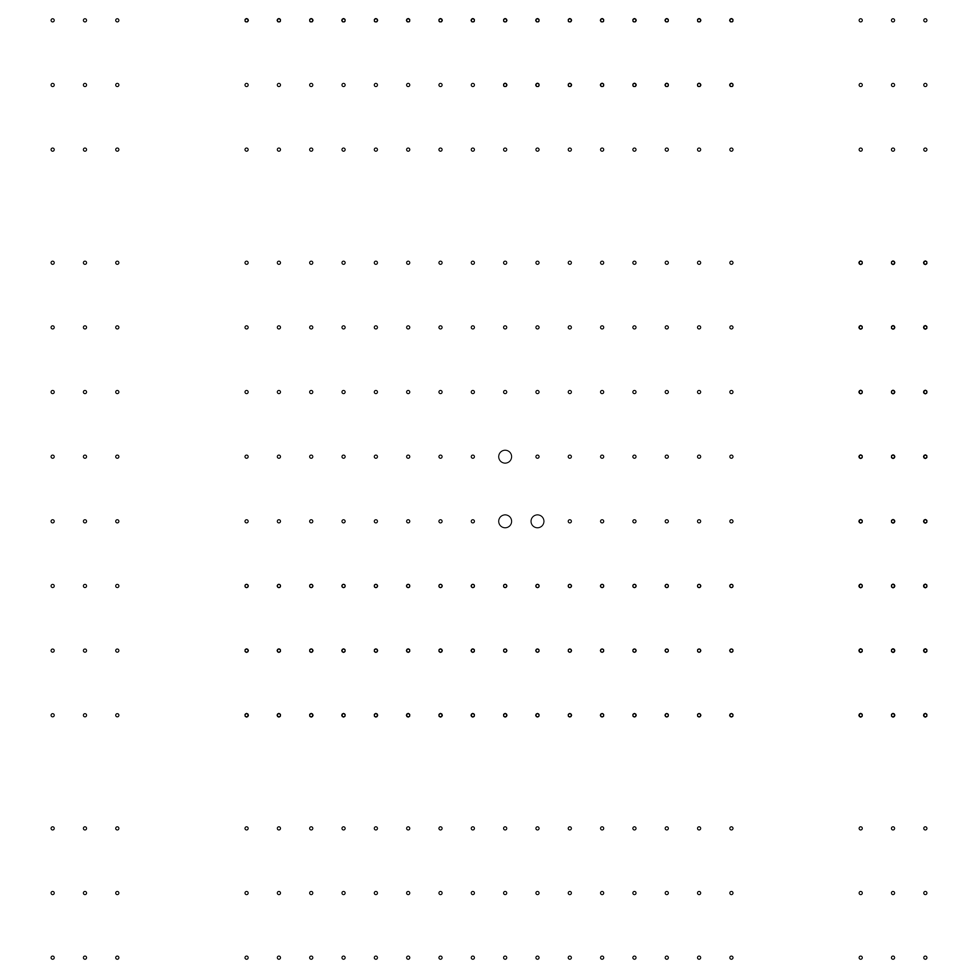
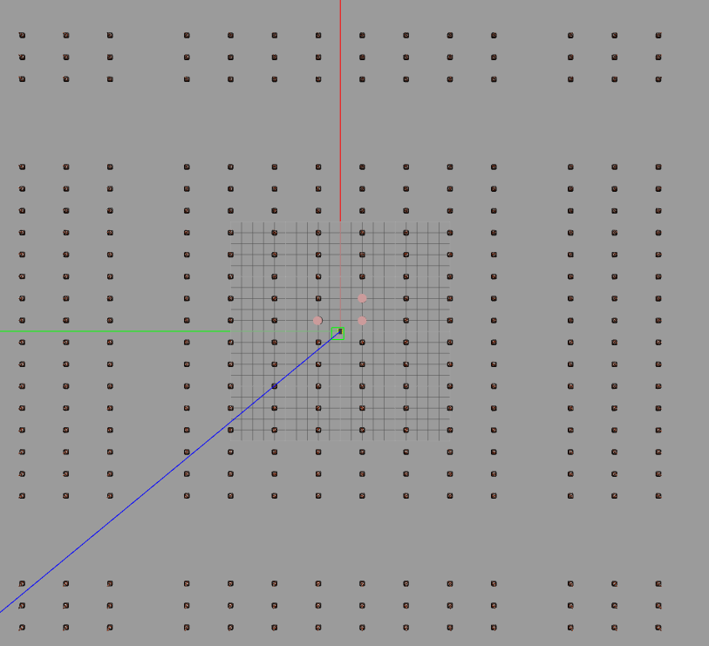
Experiment #7 : 3 cylinders both sides
Wold name: cone_orcahrd6d
World Description: 3 cylinders with radius=0.4m (4 times larger than a cone) near the axis.
Special notes: Initial injected pose (8,8). various number of particles tested .
World map & image:

Slide 33
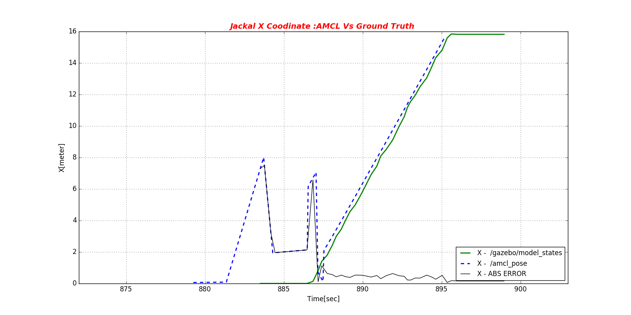
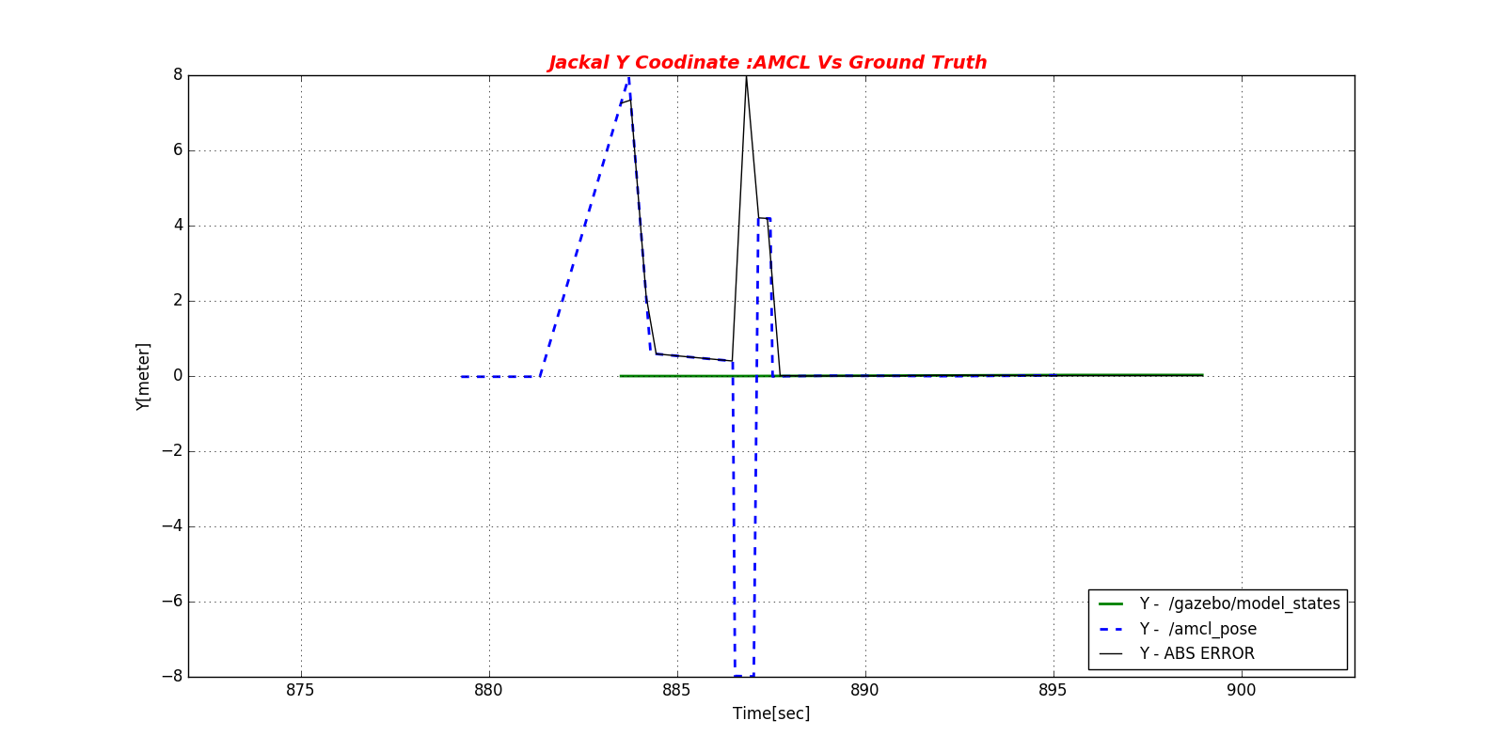
Experiment #7 : 3 cylinders both sides
Results: 5 successive simulations- 5/5 (100%) success rate with 3000 particles.
20,000 particles-1/3 success (33%). Using less particles turned to be worse.
First time that the algorithm located the robot correctly in both axis
Example success graph:

Slide 34
Conclusions and insights
The first thing which appears immediately , even before analyzing the results in detail, is that the number of particles is a key characteristic of the AMCL algorithm. The performance of the algorithm may be much worst than optimal unless this parameter is carefully chosen by the user.
As a rule of thumb – the more the merrier. If the number of particles is too low the algorithm obviously yields poor localizations results since the sampling of the map does not cover it in enough detail/resolution.
Taking a too high parameter may lead to a heavy load on the hardware resources (CPU usage, memory) , a very long convergence time and sometimes to erroneous results. This may happen if the landmark is visible for a relatively short time while the convergence time is very long. By the time the algorithm re-sampling process gets to its final steps, the landmark has already become invisible to the sensors a long time before (“obsolete”), and might be ignored.
The best thing to do is to scale this parameter on a given world (running several trials) in order to get better results. Maybe there is a method for optimizing the number of particles to a given map, but I am not aware of such method. The default number in the navigation stack (2000) was very far form those I found to work best.
One must mention that the user must initiate the global localization service himself. I would expect a good localization algorithm to invoke a “global search” automatically, especially in cases where the map does not fit the measurements for a long (predefined) period of time.

Slide 35
Conclusions and insights
A single cone/two cones were never enough. No matter whether it’s a missing cone, a cone out-of place , or a cylinder instead of a cone (which may simulate a much larger cone)- the results of the AMCL where very poor. The algorithm needs more heterogeneity than a single/two cones. This holds for any number of particles tested. The landmark should be visible for some minimum time during the convergence period .
A landmark should be a distinguishable one. Positive landmarks are better than negative ones. A missing cone or cones are usually not as good landmark as a cylinder. The experiment of 3 missing cones lead to poorer results than 3 cylinders placed in the same positions.
3 cones may cause a larger heterogeneity than an entire row of cones. When an entire row of cones was missing/out of place - this is indeed a distinguishable landmark which is seen for a long period of time. But still, If are two valid solutions (because of symmetry) surprisingly this situation sometimes lead to a totally wrong one. The amount of heterogeneity is not just counting how many cones are “out of order” but how strongly they force a single, valid solution.
The algorithm does not cope very well with 2 symmetrical valid solutions, nor it does so with ambiguity in a single axis. In the “missing row” and “out of order row” experiments the results were not very good, considering that it was a “relaxed”, single- dimensional problem- (only a valid y coordinate should be found) . On the other hand, when the 3 cones are placed in such way that cause a strong homogeneity in the area – a valid solution was usually found.

